Slide 1
Using Legislative Information Management System (LIMS ) in a multilingual parliament
Utilizando el Sistema de Gestión de Información Legislativa (SGIL) en un parlamento multilingüe
Utilisation du système de gestion d'information législative (SGIL) au parlement multilingue
Çox dilli parlamentlərdə qanunvericilik məlumatlarının idarə olunması sistemi
Использование системы управления законодательной информации в многоязычной парламентax
Shahin Hasanov

Slide 2
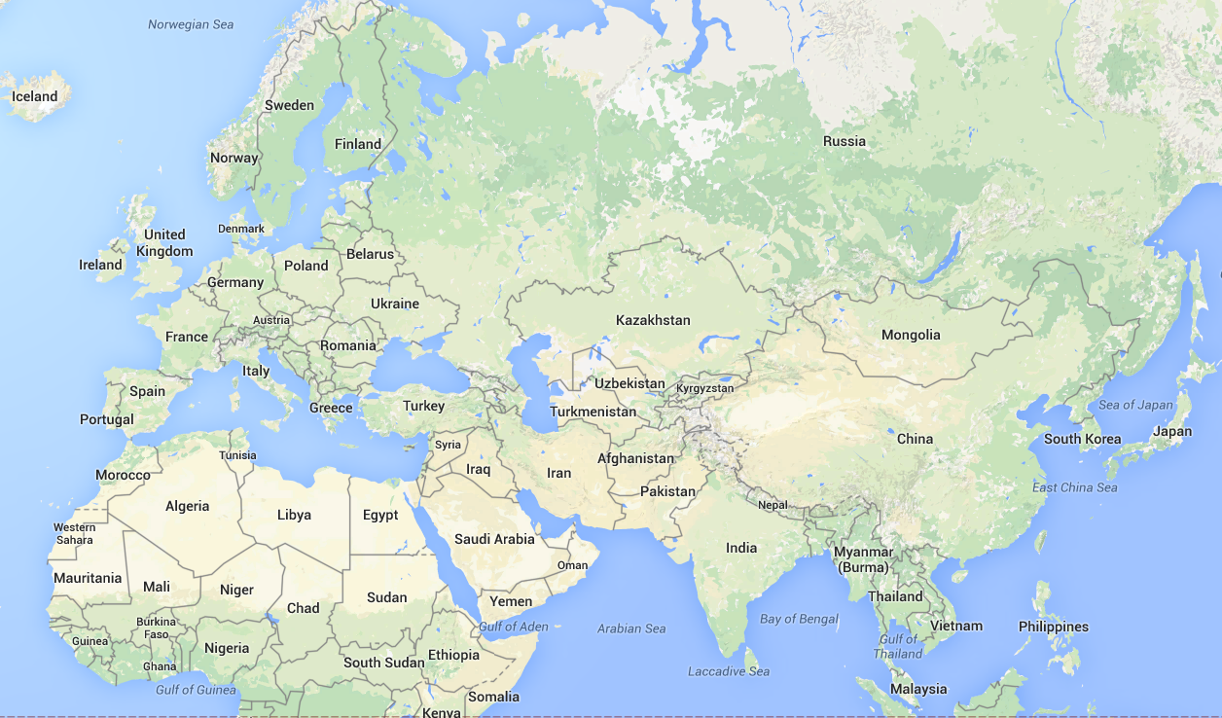
Sankt-Petersburg, ECPRD, September 19-21, 2013
Strasbourg ,ECPRD, December 18-19, 2014
Ljubljana, ECPRD, June 5-6, 2014
Baku, ECPRD, November 28-29, 2013
Seoul, IPU,
May 8-10, 2014
Shahin Hasanov

Slide 3
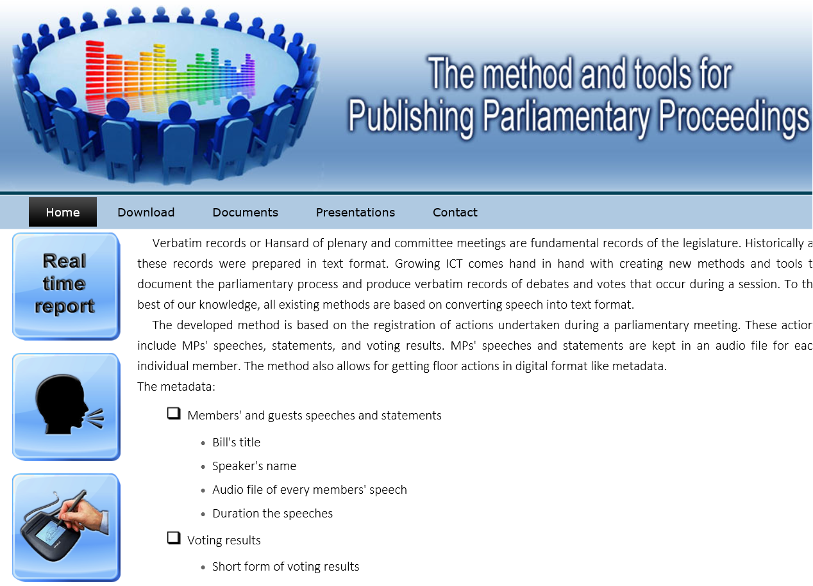
http://meclis.az/software/
Shahin Hasanov

Slide 4
All Parliaments Waste:
Time
Money
Resources
Timely & Accurately Publish
TEXT format
Preliminary version
Final version
Video format
Audio format
To Achieve
Greater Parliamentary:
Transparency
Accountability
Overall efficiency in the law-making process

Slide 5
All Parliaments Waste:
Time
Money
Resources
Related with a Sitting
Timely & Accurately Publish
TEXT format
Preliminary version
Final version
Video format
Audio format
To Achieve
Greater Parliamentary:
Transparency
Accountability
Overall efficiency in the law-making process

Slide 6
All Parliaments Waste:
Time
Money
Resources
Timely & Accurately Publish
TEXT format
Preliminary version
Final version
Video format
Audio format
To Achieve
Slow approach
Not always accurate
Editor intervention is required
Greater Parliamentary:
Transparency
Accountability
Overall efficiency in the law-making process

Slide 7
All Parliaments Waste:
Time
Money
Resources
Timely & Accurately Publish
TEXT format
Preliminary version
Final version
Video format
Audio format
Accurate
Complicated to search
Unavailable text information
To Achieve
Greater Parliamentary:
Transparency
Accountability
Overall efficiency in the law-making process

Slide 8
All Parliaments Waste:
Time
Money
Resources
TEXT format
Preliminary version
Final version
Video format
Audio format
As a result many resources are spent on the preparation of verbatim records in text format
Greater Parliamentary:
Transparency
Accountability
Overall efficiency in the law-making process

Slide 9
All Parliaments Waste:
Time
Money
Resources
The approach is based on keeping the speeches of every speaker in audio format
The speech of a every speaker are published online upon its completion.
Greater Parliamentary:
Transparency
Accountability
Overall efficiency in the law-making process

Slide 10
E-verbatim records
It is not online,
it is added later
A title, the subject
Speaker’s name
Duration of the speech
Links to the audio file
Links to the text of the speaker
Speaker’s name
Duration of the speech
Links to the audio file
Links to the text of the speaker
A title, the subject
Speaker’s name
Duration of the speech
Links to the audio file
Links to the text of the speaker
Speaker’s name
Duration of the speech
Links to the audio file
Links to the text of the speaker

Slide 11
E-verbatim records
It is not online -
We add it during the month
It will be available 1 hour later after the sitting
A title the subject
Speaker’s name
Duration of the speech
Links to the audio file
Links to the text of the speaker
Links to the video file
Speaker’s name
Duration of the speech
Links to the audio file
Links to the text of the speaker
Links to the video file
A title the subject
Speaker’s name
Duration of the speech
Links to the audio file
Links to the text of the speaker
Links to the video file
Speaker’s name
Duration of the speech
Links to the audio file
Links to the text of the speaker
Links to the video file

Slide 12



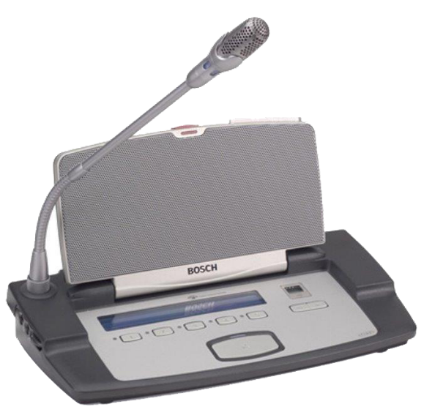
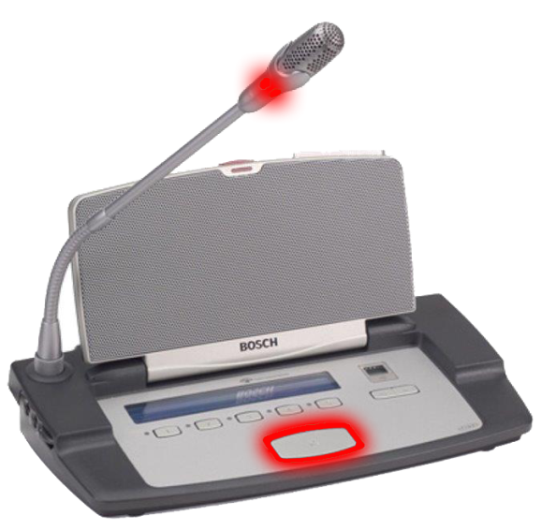

Elements of the system implementing this method
Control recorder
Audio recorder
File server
for audio files
WEB server

Slide 13



This approach in multilingual parliament
Control recorder
Audio recorder
Audio recorder
Interpreters
File server
for audio files
Audio recorder
WEB server
Audio recorder

Slide 14
E-verbatim records
A title the subject
Floor speech
AZ
EN
SPA
Speaker’s name
Duration of the speech
Links to the audio file
Links to the audio file
Links to the audio file
Links to the audio file
Speaker’s name
Duration of the speech
Links to the audio file
Links to the audio file
Links to the audio file
Links to the audio file
A title the subject
Speaker’s name
Duration of the speech
Links to the audio file
Links to the audio file
Links to the audio file
Links to the audio file
Speaker’s name
Duration of the speech
Links to the audio file
Links to the audio file
Links to the audio file
Links to the audio file

Slide 15
As a result, we will have the following advantages:
  This approach gives accurate speech for every speaker.
  We have on-line speech for every speaker next to it the translation of this speech in different languages. This will allow everybody to listen to his speech in a different language.
  We will use our resources [time, money, people] more effectively.
  It will allow for easy search by MP’s name and on the subjects debated or discussed.
  It is integrated into different workflows systems, which we use and get reports like:
          E-minutes
          Legislation information tracking system
  It is able to confirm the reports with electronic signature.

Slide 16
Thank you for your attention
Merci de votre attention
Diqqətinizə görə təşəkkür edirəm
Gracias por su atención
Спасибо за внимание

