Slide 1

E-Hansard: Digital Mirror of Legislative Procedure, Practices and Records
Azerbaijan Parliament
Shahin Hasanov
Head of Information
Resources &Technology
shahinhasanov@meclis.gov.az
shahinhasanov@hotmail.com

Slide 2
Demand for publishing parliamentary proceeding:
Quickly
Accurately
Efficiently
Comprehensively
Archived to ensure their availability over a long period of time

Slide 3
This presentation will ….
Present how available methods¹ correspond to the demands
How the method developed in-house at the National Assembly of the Republic of Azerbaijan satisfy to the demands
Share the benefits of our approach/IT solution
Examine the view of the two digital reports of publishing parliamentary proceeding
1 United Nations Department of Economic and Social Affairs, Inter-Parliamentary Union, Technological Options for Capturing and Reporting Parliamentary Proceedings

Slide 4


Before the meeting
During the meeting
After the meeting
Departments
Agenda
Format:
PDF
DOC
Format:
HTML
XML
Text of the bill
Other related documents
Reference
Resolution
Report
Etc.
Final Report or Hansard
Final Report or Hansard
Verbatim record
Audio and video recording

Slide 5


The current approaches are based on converting speeches
into text format, the difference of these approaches
depends on the conversion methods used.
Do existing approaches fit for the demands of publishing parliamentary proceeding?

Slide 6
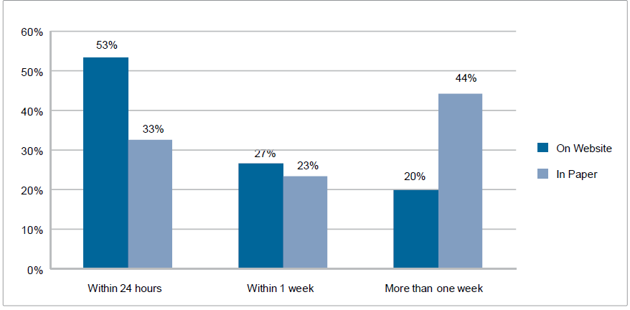
Quickly …
Best result for verbatim record is 2 hours after the meeting
Average time to publish verbatim records of the plenary proceedings
Final report needs more time

Slide 7
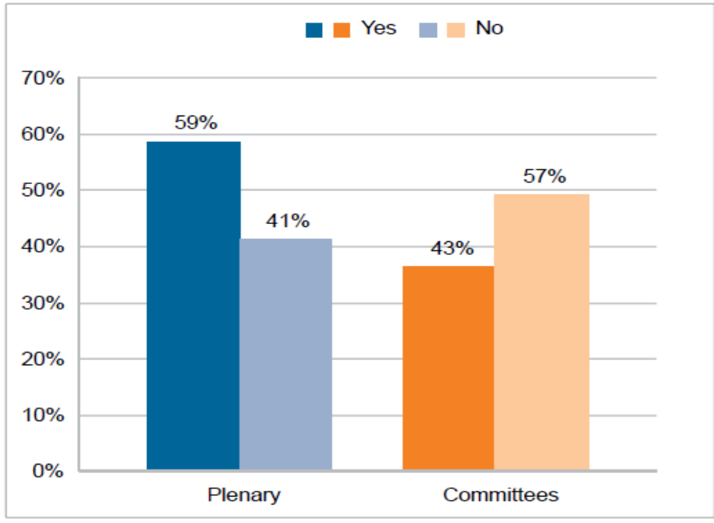
Accurately …
59% of parliaments make changes in order to make it understandable
Members of parliament are allowed to revise verbatim record
Challenge:
what type of corrections to allow by reporters and editors to do on text format in order to make it understandable

Slide 8
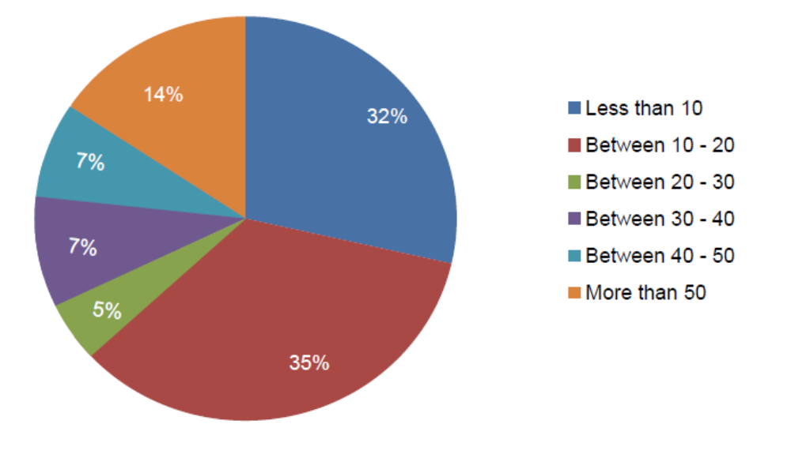
Effectively …
Requires sufficient resources like:
Staff
IT tools
Total number of staff responsible for preparing
and processing verbatim records of plenary
and committee proceedings

Slide 9
Efficiently …
Requires sufficient resources like
Staff
IT tools
Total number of staff responsible for preparing and processing verbatim records of plenary
and committee proceedings
68 % of parliaments hire more than 10 staff persons
Staff must be knowledgeable about the legislative process
Typing on a stenographic machine
Typing on a PC
Voice-to-text system

Slide 10



Comprehensively …
Link to audio and video file
Link to related documents of the bill
▪ More time
▪ Extra works
▪ Cooperation
departments
The text of bills
Related documents of the bills
Letters and other correspondence from executive
Etc.
Deadline for publication may lead to a limit of including documentation
Time, work
Agenda
Debates & statements
Proposals
Voting results

Slide 11


The method used in the National Assembly of Azerbaijan is based on keeping floor actions in the same format
Members’ and guests speeches and statements
Audio format, wav
Other actions
in text format: pdf, html
Audio file 1
Audio file 2
Audio file 3

Slide 12
DATABASE
Before the meeting
During the meeting
Departments
Agenda
Actions undertaken during the meetings
Members’ and guests speeches and statements:
Bill’s title
Speaker’s name
Audio file of every members’ speech
Duration the speeches
Voting results:
Short form of voting results
Roll-call voting record
Proposal
ID: date, meeting number
Text of the bill
Other related documents
Reference
Resolution
Report
Etc.
E-minutes
E-Verbatim record

Slide 13
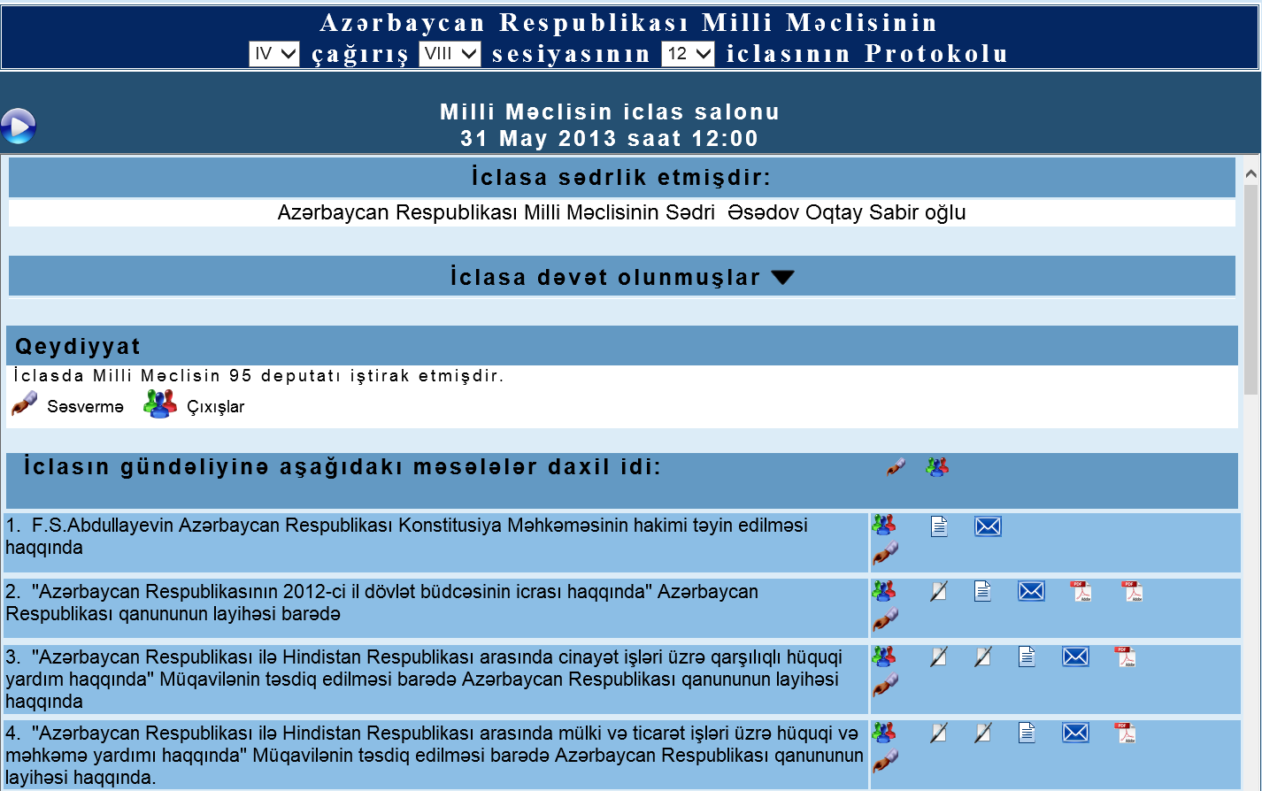
E-minutes
Place and date of the meeting
Chairman of the
meeting
List of guests
Attendance registration
Debates & voting results about agenda
Agenda

Slide 14
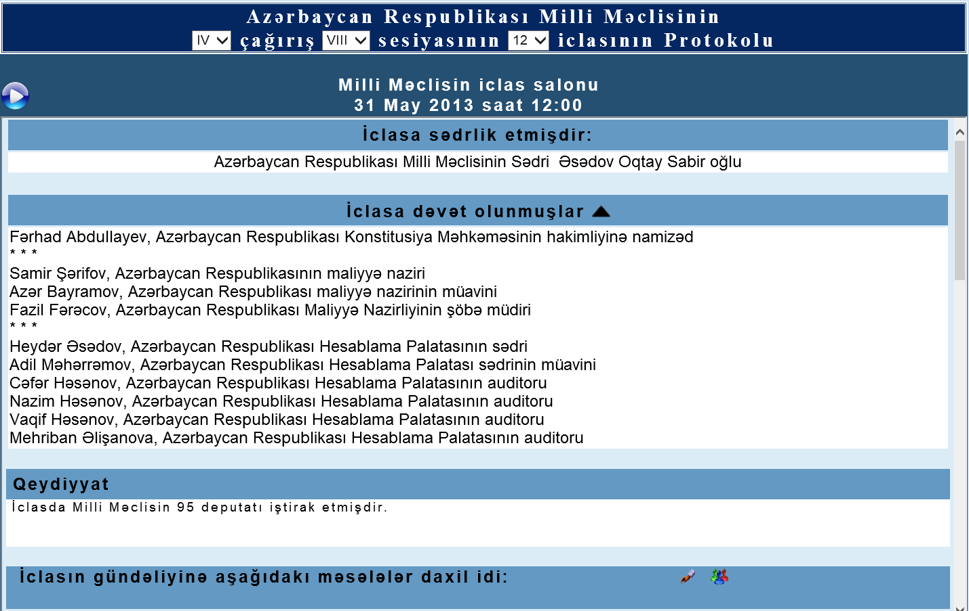
E-minutes
List of guest:
name, occupation, etc.

Slide 15



E-minutes
→ List of speakers participating in the debate
→ Voting results
↓
The text and related documents of the bill

Slide 16
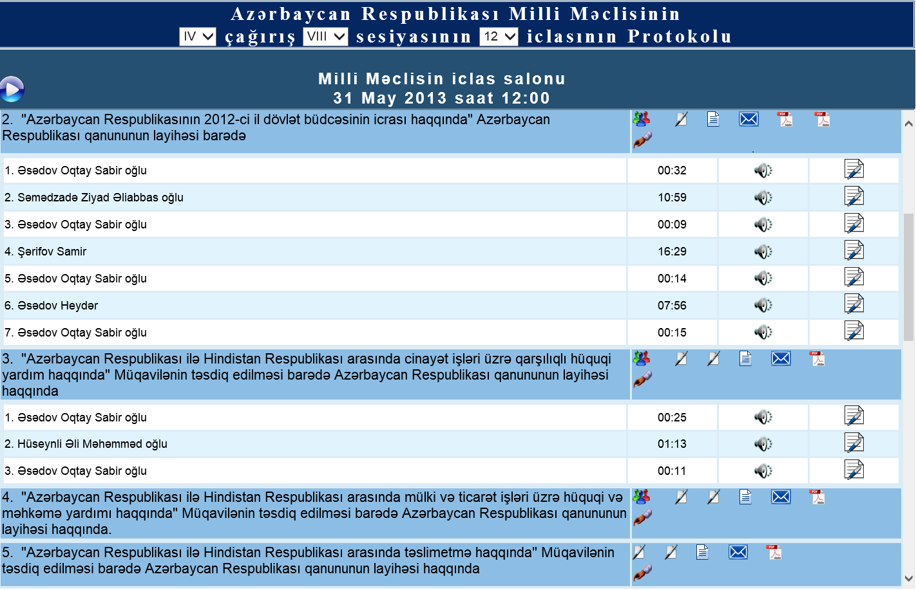


E-minutes
→ The link to the audio file
→ The text version of the speech
xx:xx
→ Duration of the speech

Slide 17
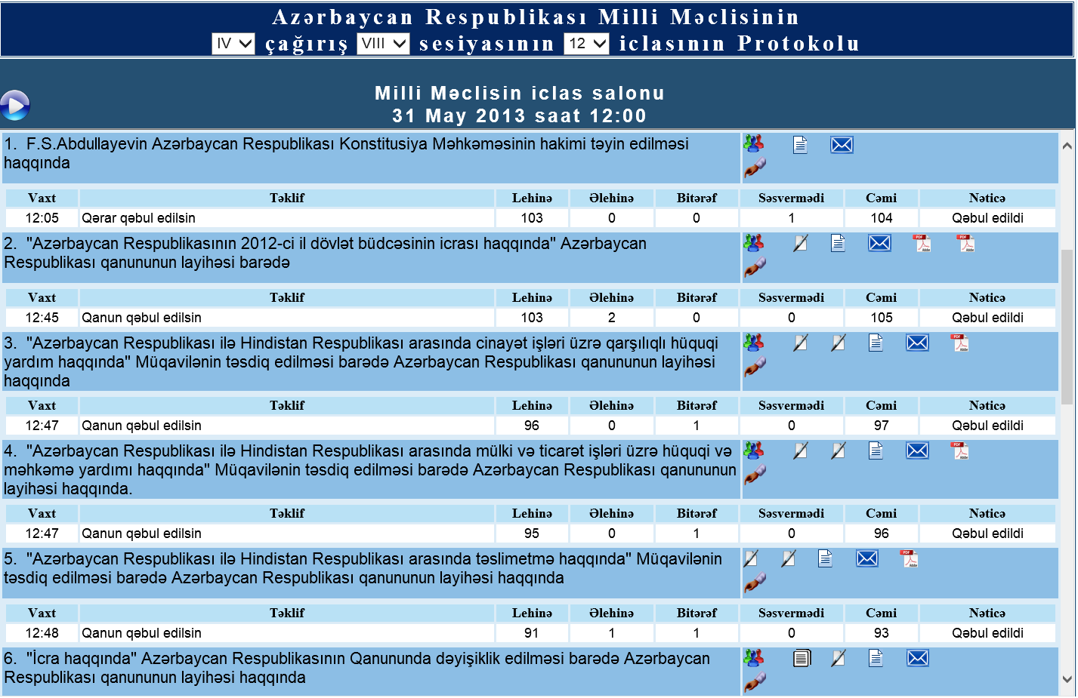
E-minutes
Vote Details
12:05 → time of vote
Proposal of vote
Yes 103
No 0
Abstain 0
Not voted 1
Total 104
Result → Adopted

Slide 18
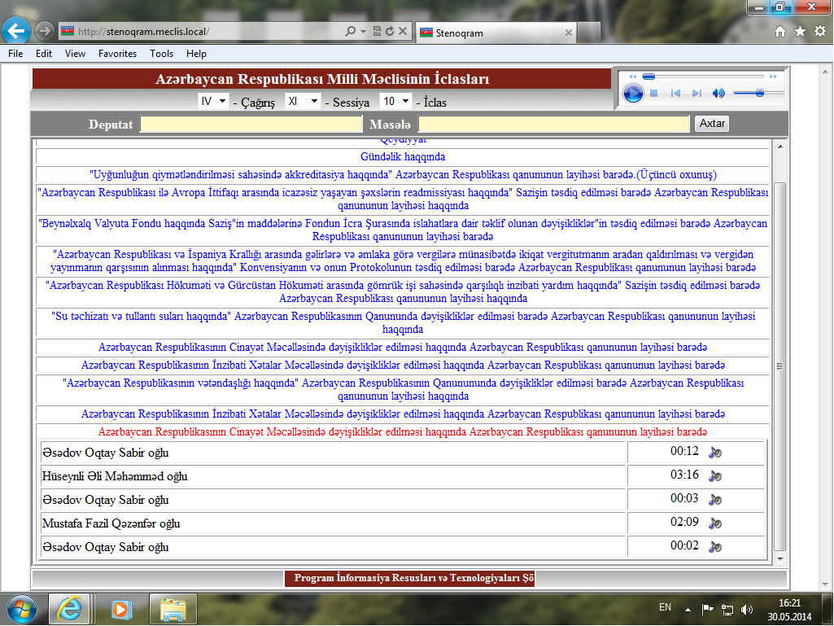
Quickness
Real time report
16:21

Slide 19
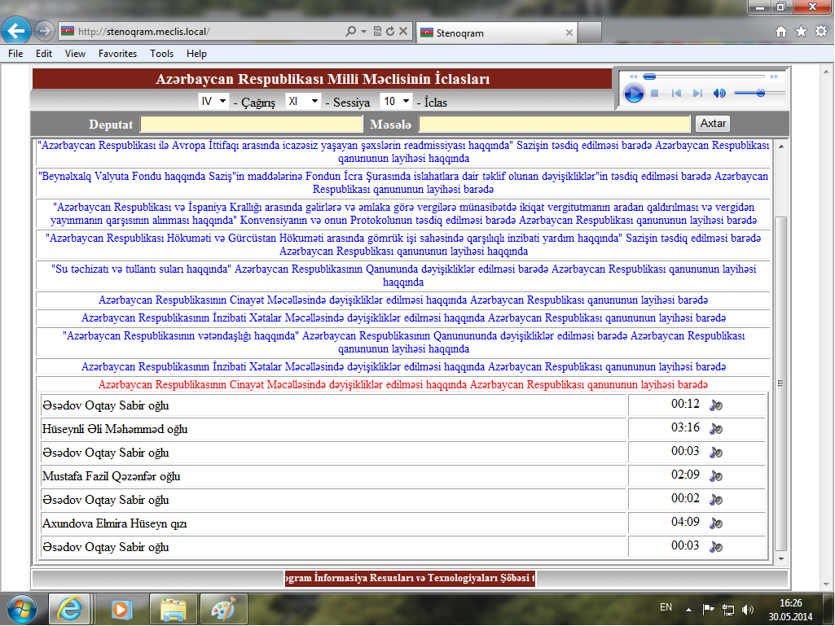
Quickness
Real time report
16:26

Slide 20
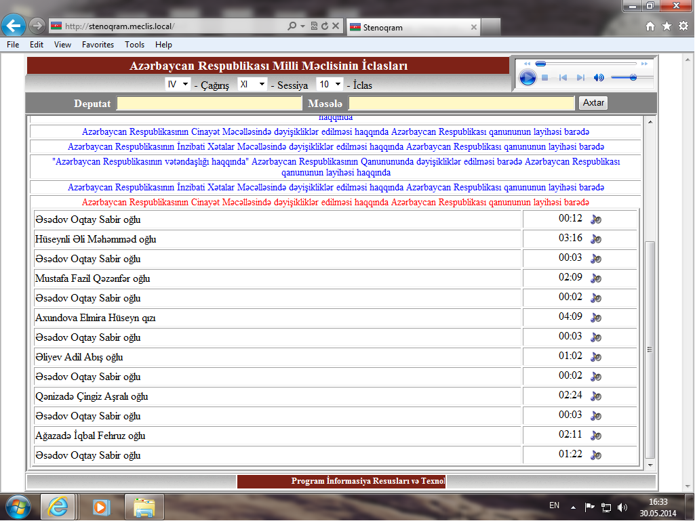
Quickness
Real time report
16:33

Slide 21


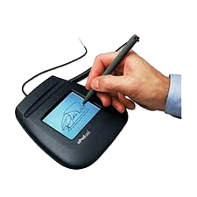
The method satisfies the requirements of publishing parliamentary proceedings
Quickness: Real time report
Accuracy: High accuracy
Real time report
E-minutes
Completeness
Effectiveness
E-verbatim records
Easy scan
Ability to create a variety form of report
FULL
Best method for individuals who are visually impaired
Ability to confirm the reports with electronic signature.
0 staff

Slide 22

The method and the system have been described in …
  World e-Parliament Conference 2014: "Lessons learned and future horizons“
Seoul, 8-10 May, 2014
http://wepc2014.files.wordpress.com/2014/05/hasanov1.pdf
  ECPRD Seminar "Area of Interest ICT in Parliaments“: "Sharing Experiences and Solutions for an ICT Based Parliament"
Baku, November 28-29, 2013
http://www.meclis.az/ecprd2013/DOC/2_Nov_28_AZ_Shahin Hasanov.pptx
  We made special website devoted the method:
http://meclis.az/software

Slide 23

THANKS FOR YOUR KIND ATTENTION

