Slide 1
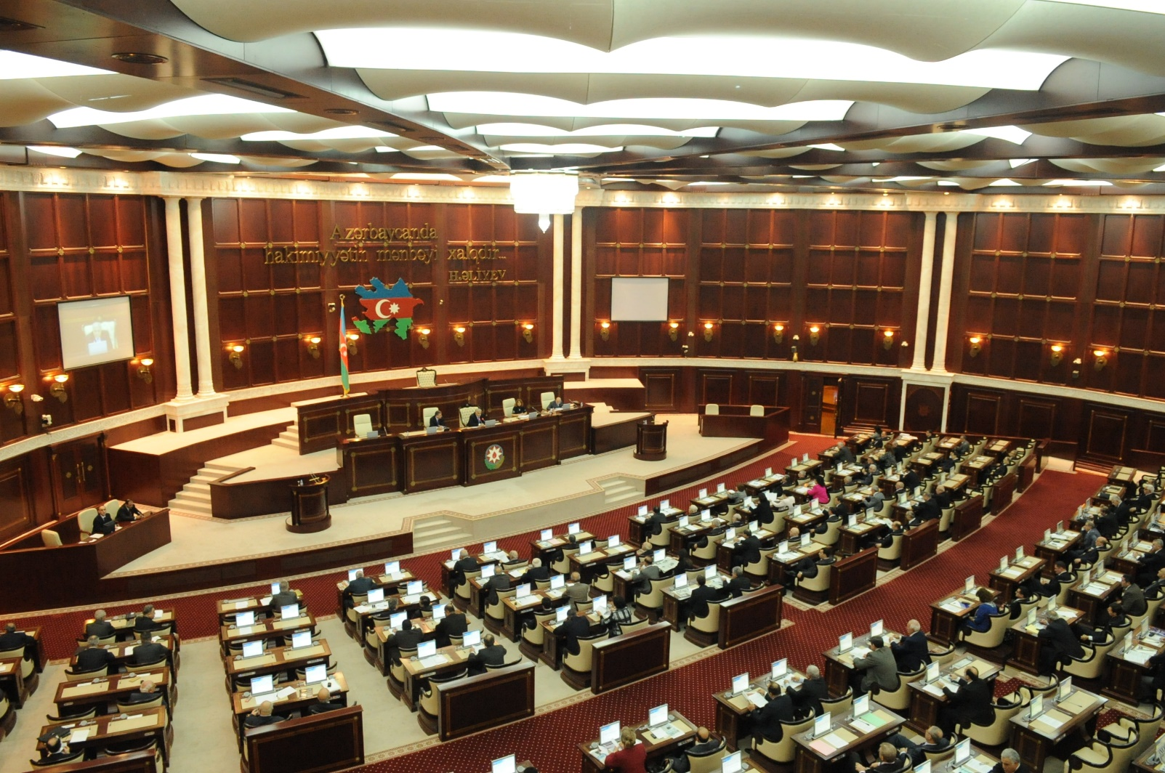
Some of examples on visualization of parliamentary data
Shahin Hasanov, Head of Department on Information Resources and Technologies
Email:shahinhasanov@meclis.gov.az, shahinhasanov@hotmail.com
The Milli Mejlis (Parliament) of the Republic of Azerbaijan

Slide 2
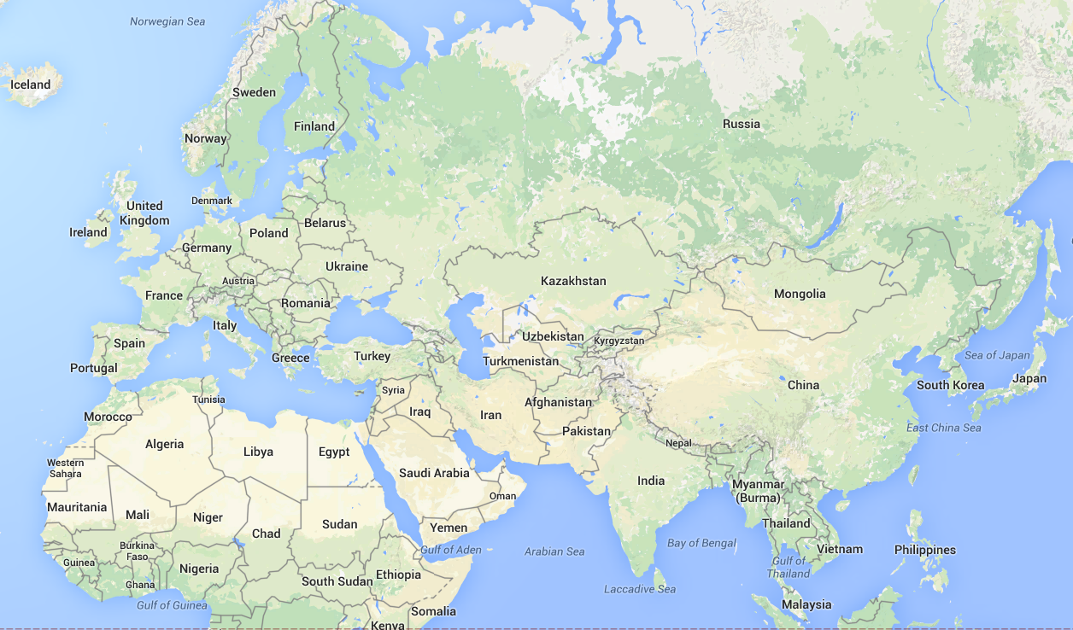
The presentations : http://www.meclis.az/software/
Sankt-Petersburg, ECPRD, September 19-21, 2013
Brussels, ECPRD, April 16-17, 2015
Strasbourg ,ECPRD, December 18-19, 2014
Ljubljana, ECPRD, June 5-6, 2014
Baku, ECPRD, November 28-29, 2013
Seoul, IPU,
May 8-10, 2014
Shahin Hasanov, Head of Department on Information Resources and Technologies
Email:shahinhasanov@meclis.gov.az, shahinhasanov@hotmail.com
The Milli Mejlis (Parliament) of the Republic of Azerbaijan

Slide 3

Parliaments' functions:
representing the electorate
making laws
overseeing the government
via hearings
&
inquiries
Database
Visualize data with applications :
E-verbatim records (functions 2007)
E-minutes (functions 2010)
Legislation information tracking system (updated 2010)
etc.
Shahin Hasanov, Head of Department on Information Resources and Technologies
Email:shahinhasanov@meclis.gov.az, shahinhasanov@hotmail.com
The Milli Mejlis (Parliament) of the Republic of Azerbaijan

Slide 4

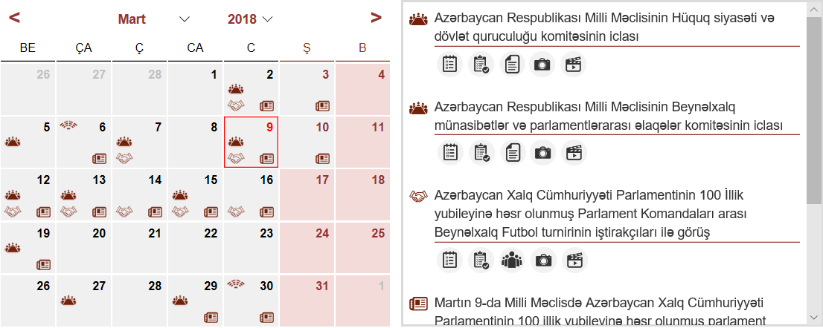
Calendar:
Plenary meeting
Committee meetings, public hearings
Other meeting (30 types)
News
Meetings of the Committee on Legal Policy and State Building
Meetings of the Committee on International and Parliamentary Relations
2
2
Meeting participants of international parliamentary football teams, dedicated to the 100th anniversary of the Azerbaijani parliament.
Shahin Hasanov, Head of Department on Information Resources and Technologies
Email:shahinhasanov@meclis.gov.az, shahinhasanov@hotmail.com
The Milli Mejlis (Parliament) of the Republic of Azerbaijan

Slide 5


Meetings: Plenary meetings
Agenda
E-verbatim records
Applications
E-Minutes of meetings
Video of the meeting
Photo gallery of the meeting
Shahin Hasanov, Head of Department on Information Resources and Technologies
Email:shahinhasanov@meclis.gov.az, shahinhasanov@hotmail.com
The Milli Mejlis (Parliament) of the Republic of Azerbaijan

Slide 6

Meetings:
Committee meetings
Other meetings
Program
Agenda (html format)
Participants
Verbatim records
Video of the meeting
Minutes of meetings
Photo gallery
Video of the meeting
Photo gallery
Shahin Hasanov, Head of Department on Information Resources and Technologies
Email:shahinhasanov@meclis.gov.az, shahinhasanov@hotmail.com
The Milli Mejlis (Parliament) of the Republic of Azerbaijan

Slide 7
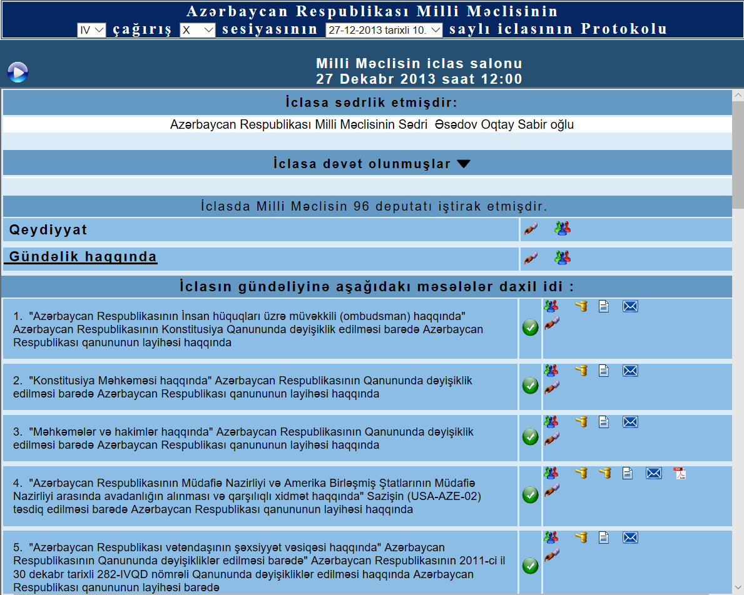
E-Minutes
Convocation
Session
location:
Date & number of meeting
Video
beginning of the meeting
chairman of the meeting
Accompanying documents of the draft legislation
List of guests
Registration
Number of present MP's
Discussion about
the agenda
Agenda
Shahin Hasanov, Head of Department on Information Resources and Technologies
Email:shahinhasanov@meclis.gov.az, shahinhasanov@hotmail.com
The Milli Mejlis (Parliament) of the Republic of Azerbaijan

Slide 8
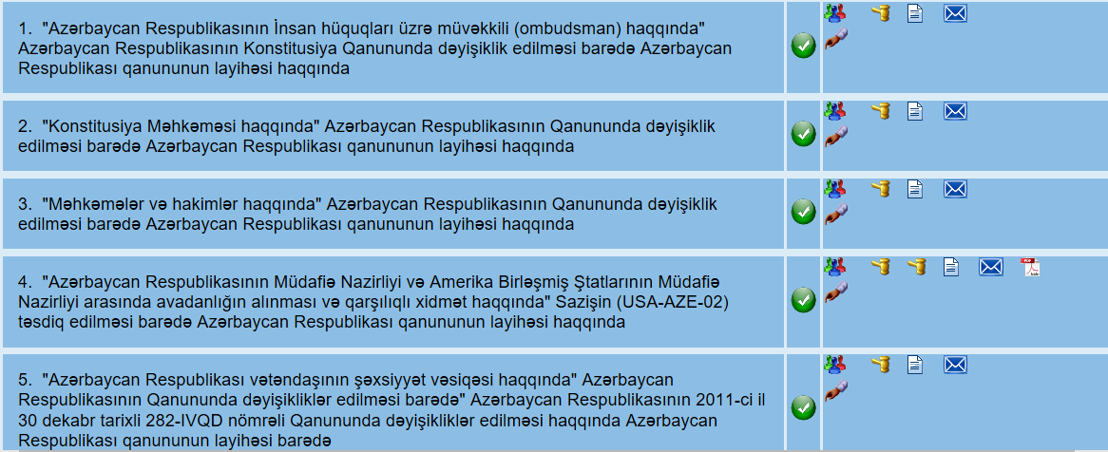
E-Minutes
Status of the draft legislation
Events of the meeting related
to the draft legislation
The text and accompanying documents of the draft legislation
Agenda: Titles of draft legislation
Shahin Hasanov, Head of Department on Information Resources and Technologies
Email:shahinhasanov@meclis.gov.az, shahinhasanov@hotmail.com
The Milli Mejlis (Parliament) of the Republic of Azerbaijan

Slide 9







Signs have used in the Application of E-Minutes
Status of the draft legislation on the meeting:
1)
has not been considered yet
2)
the discussion began, it is continue
3)
the discussion has been completed, to be continued
4)
adopted
5)
was discussed at the previous meeting
6)
was adopted at the previous meeting
7)
the draft legislation is not adopted
Shahin Hasanov, Head of Department on Information Resources and Technologies
Email:shahinhasanov@meclis.gov.az, shahinhasanov@hotmail.com
The Milli Mejlis (Parliament) of the Republic of Azerbaijan

Slide 10

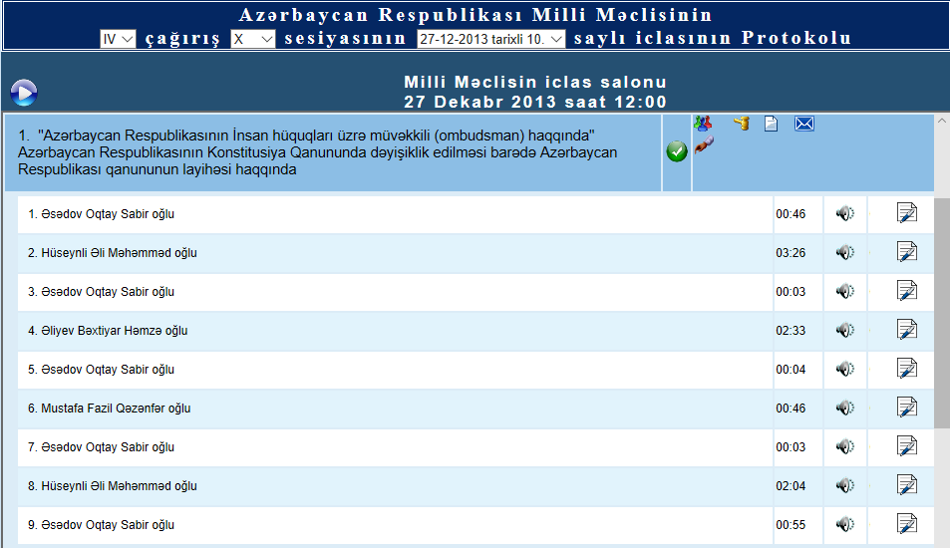


Signs have used in the Application of E-Minutes
List of the speakers on a draft legislation at the meeting
The name of the speaker
The link to the audio file of the speaker’s speech
The text of the speech
Shahin Hasanov, Head of Department on Information Resources and Technologies
Email:shahinhasanov@meclis.gov.az, shahinhasanov@hotmail.com
The Milli Mejlis (Parliament) of the Republic of Azerbaijan

Slide 11
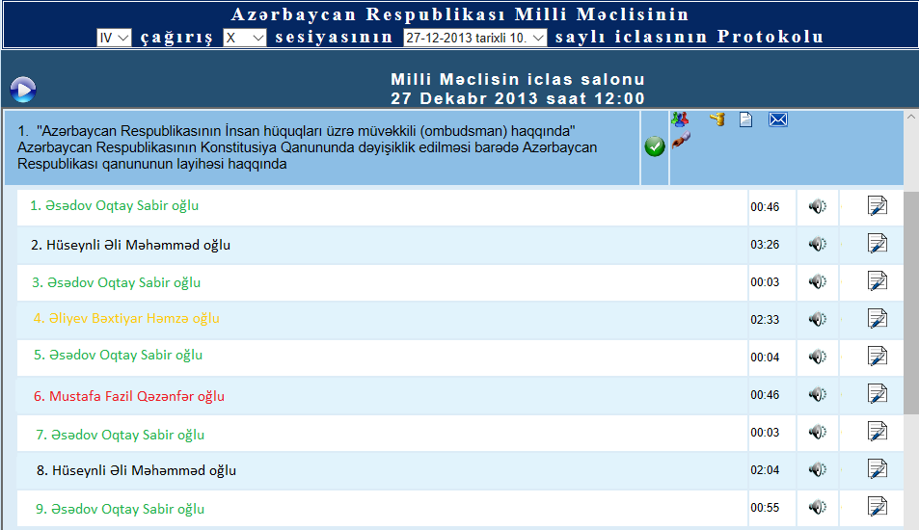
Signs have used in the Application of E-Minutes
List of the speakers on a draft legislation at the meeting
Adding new features in the future, such as a vote of the speaker by color
The name of the speaker with his vote
Yes
No
Abstained
Did not vote
Shahin Hasanov, Head of Department on Information Resources and Technologies
Email:shahinhasanov@meclis.gov.az, shahinhasanov@hotmail.com
The Milli Mejlis (Parliament) of the Republic of Azerbaijan

Slide 12

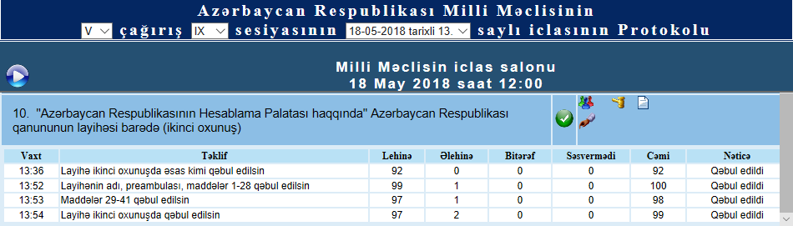
Signs have used in the Application of E-Minutes
Voting results on the draft legislation at the meeting
The time of the vote | Proposal | Yes | No |  | Didn’t vote |  | Decision
Abstained
Total
Shahin Hasanov, Head of Department on Information Resources and Technologies
Email:shahinhasanov@meclis.gov.az, shahinhasanov@hotmail.com
The Milli Mejlis (Parliament) of the Republic of Azerbaijan

Slide 13





Signs have used in the Application of E-Minutes
Text and accompanying documents of the draft legislation:
Cover letter from the Legislative Initiative body
the text of the draft legislation
the decision of the appropriate committee
explanatory to the text of the draft legislation
other kind of documents. For example:
Reports
Memorandum
Agreement etc.
31 types
Shahin Hasanov, Head of Department on Information Resources and Technologies
Email:shahinhasanov@meclis.gov.az, shahinhasanov@hotmail.com
The Milli Mejlis (Parliament) of the Republic of Azerbaijan

Slide 14

THANK YOU FOR YOUR
ATTENTION
?
Shahin Hasanov, Head of Department on Information Resources and Technologies
Email:shahinhasanov@meclis.gov.az, shahinhasanov@hotmail.com
The Milli Mejlis (Parliament) of the Republic of Azerbaijan

