Slide 1

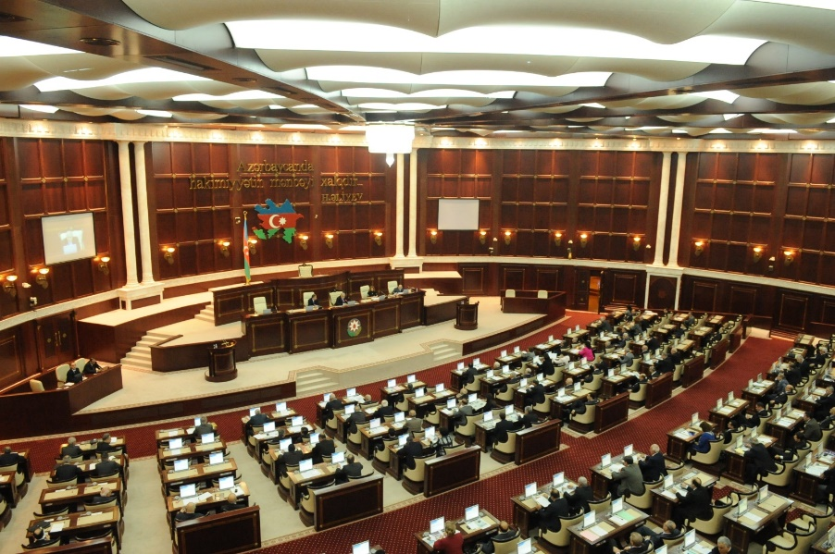
Indexing video data of plenary session based on timestamps
Shahin Hasanov, Head of Department on Information Resources and Technologies
Email:shahinhasanov@meclis.gov.az, shahinhasanov@hotmail.com
The Milli Mejlis (Parliament) of the Republic of Azerbaijan

Slide 2

Information getting from the floor action
Members’ and guests speeches and statements:
Bill’s title
Speaker’s name
Audio file of every members’ speech
Duration the speeches
Voting results
  Roll-call voting record
  Proposal
ID: date, meeting number
Shahin Hasanov, Head of Department on Information Resources and Technologies
Email:shahinhasanov@meclis.gov.az, shahinhasanov@hotmail.com
The Milli Mejlis (Parliament) of the Republic of Azerbaijan

Slide 3

WEB applications
E-verbatim records
E-minutes
Legislation Information Tracking System
MP’s Activities
Shahin Hasanov, Head of Department on Information Resources and Technologies
Email:shahinhasanov@meclis.gov.az, shahinhasanov@hotmail.com
The Milli Mejlis (Parliament) of the Republic of Azerbaijan

Slide 4
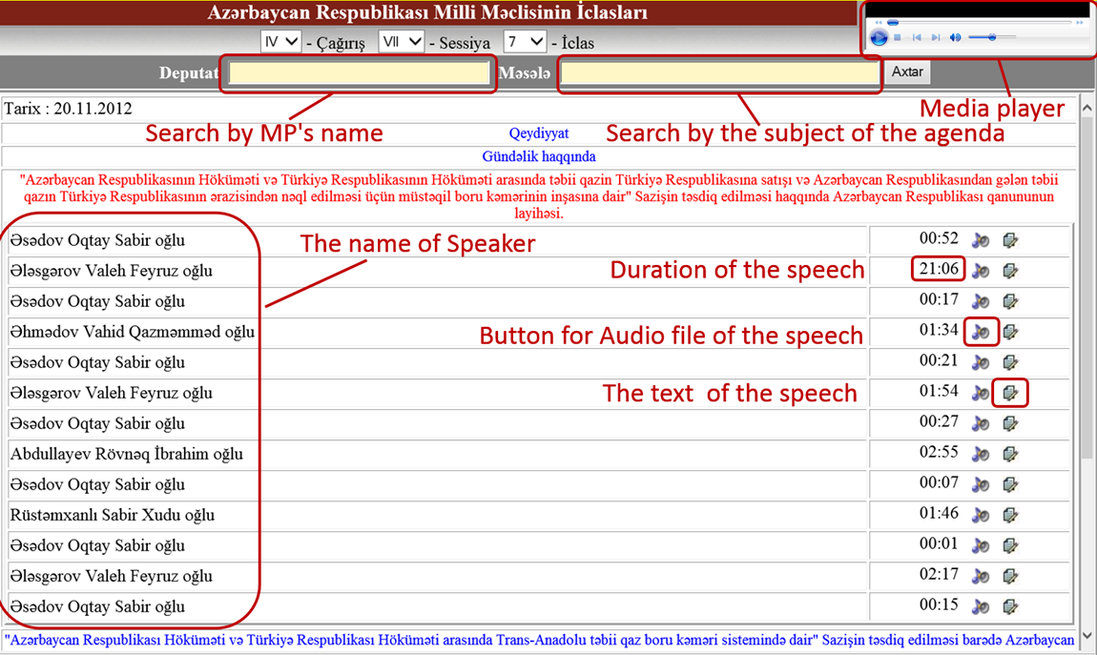
E-Verbatim Records
Shahin Hasanov, Head of Department on Information Resources and Technologies
Email:shahinhasanov@meclis.gov.az, shahinhasanov@hotmail.com
The Milli Mejlis (Parliament) of the Republic of Azerbaijan

Slide 5
E-Verbatim Records
Button for video file of speaker
Shahin Hasanov, Head of Department on Information Resources and Technologies
Email:shahinhasanov@meclis.gov.az, shahinhasanov@hotmail.com
The Milli Mejlis (Parliament) of the Republic of Azerbaijan

Slide 6
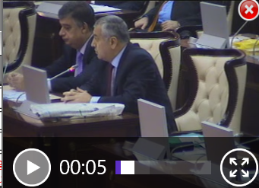

E-Verbatim Records
Button for video file of speaker
Shahin Hasanov, Head of Department on Information Resources and Technologies
Email:shahinhasanov@meclis.gov.az, shahinhasanov@hotmail.com
The Milli Mejlis (Parliament) of the Republic of Azerbaijan

Slide 7
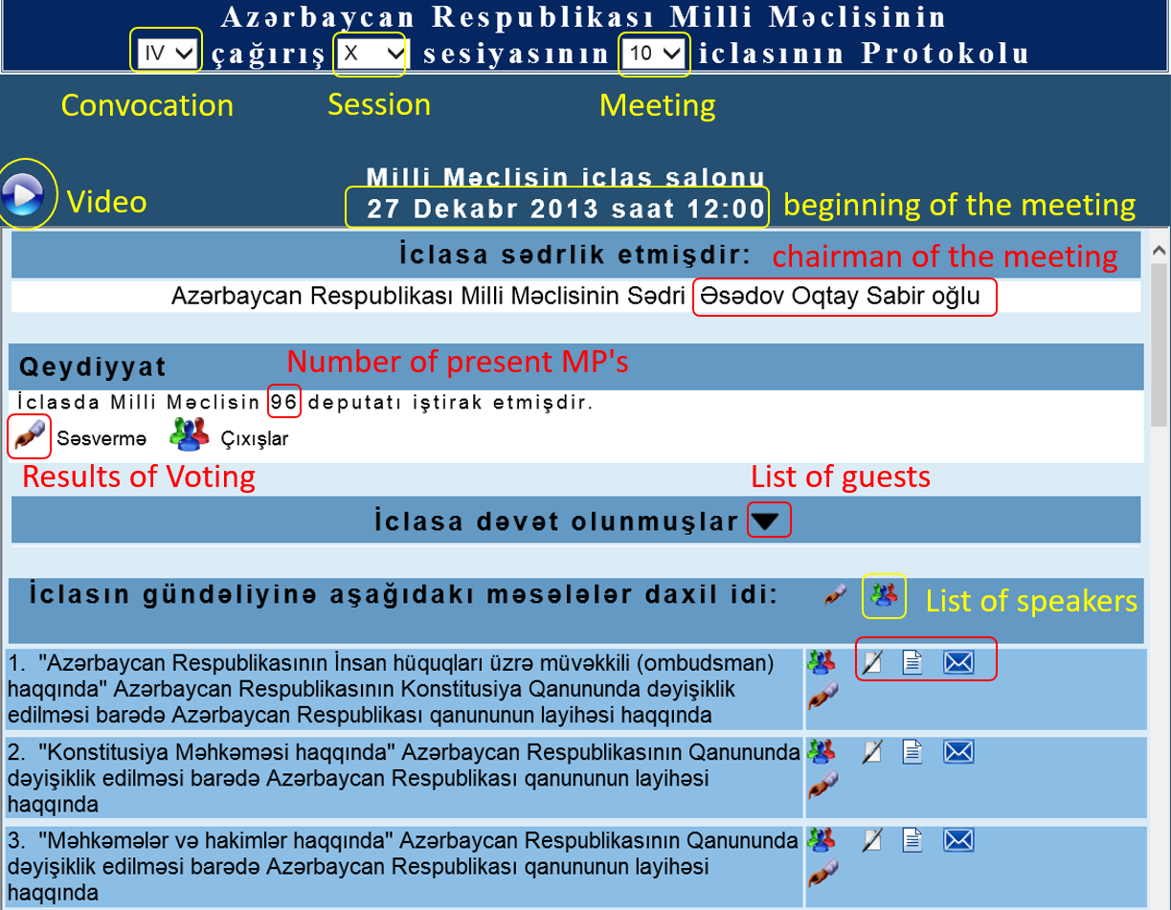
E-Minutes
Registration
Discussion
about
the agenda
Accompanying documents of the bill
Agenda
Shahin Hasanov, Head of Department on Information Resources and Technologies
Email:shahinhasanov@meclis.gov.az, shahinhasanov@hotmail.com
The Milli Mejlis (Parliament) of the Republic of Azerbaijan

Slide 8
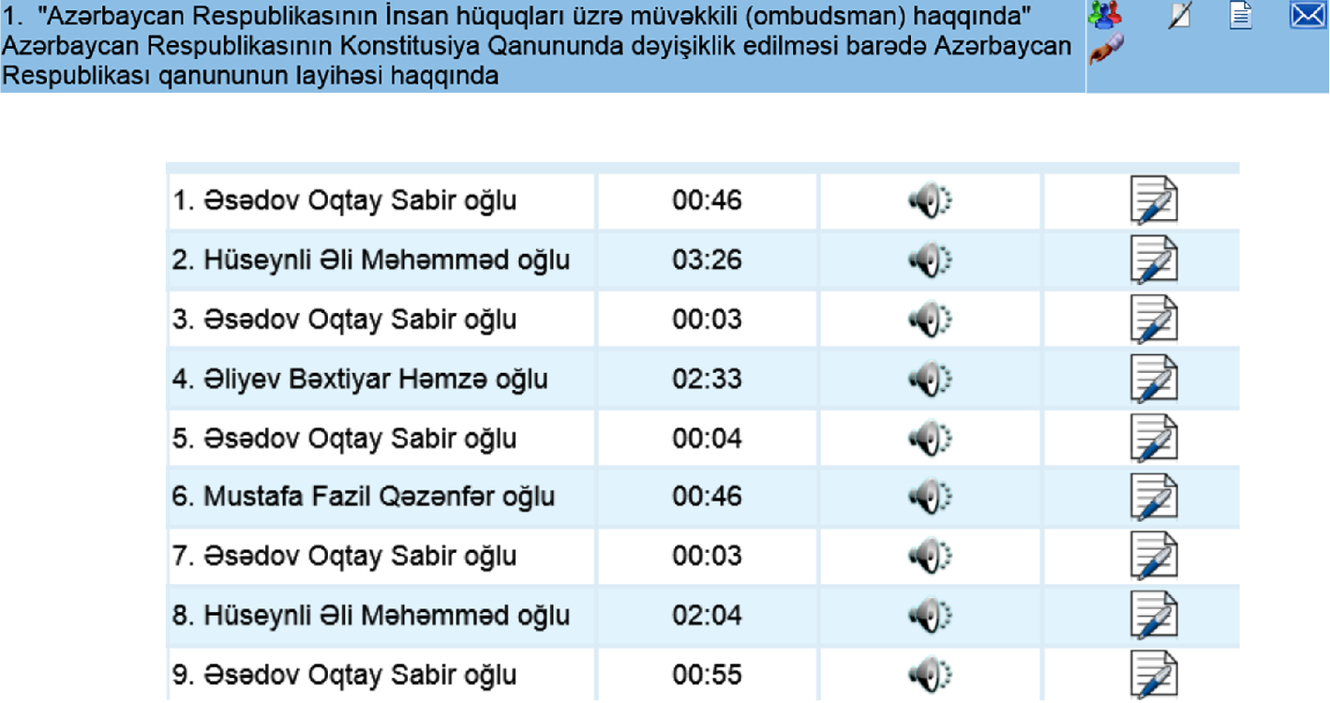
E-Minutes: List of speakers
The name of the speaker
Duration of the speech
The audio of the speech
The text of the speech
Shahin Hasanov, Head of Department on Information Resources and Technologies
Email:shahinhasanov@meclis.gov.az, shahinhasanov@hotmail.com
The Milli Mejlis (Parliament) of the Republic of Azerbaijan

Slide 9
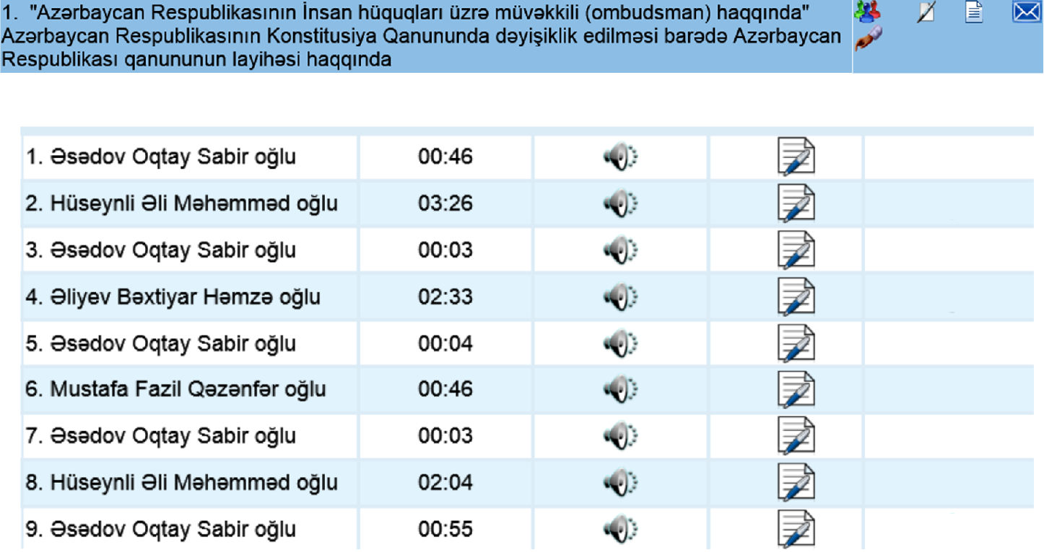

E-Minutes: List of speakers
The name of the speaker
Duration of the speech
The audio of the speech
The text of the speech
The video file
of speaker
Shahin Hasanov, Head of Department on Information Resources and Technologies
Email:shahinhasanov@meclis.gov.az, shahinhasanov@hotmail.com
The Milli Mejlis (Parliament) of the Republic of Azerbaijan

Slide 10
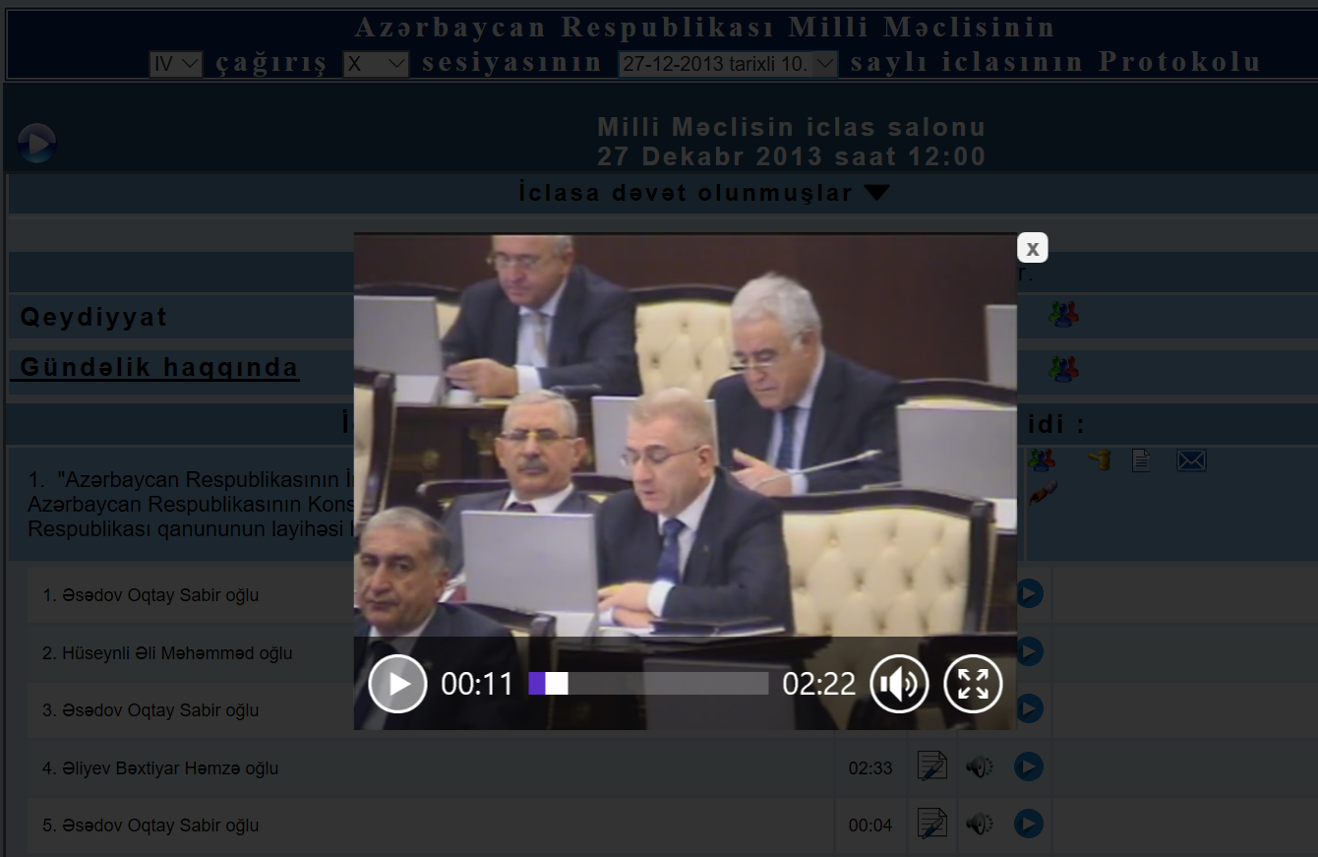
E-Minutes: The speaker
Shahin Hasanov, Head of Department on Information Resources and Technologies
Email:shahinhasanov@meclis.gov.az, shahinhasanov@hotmail.com
The Milli Mejlis (Parliament) of the Republic of Azerbaijan

Slide 11
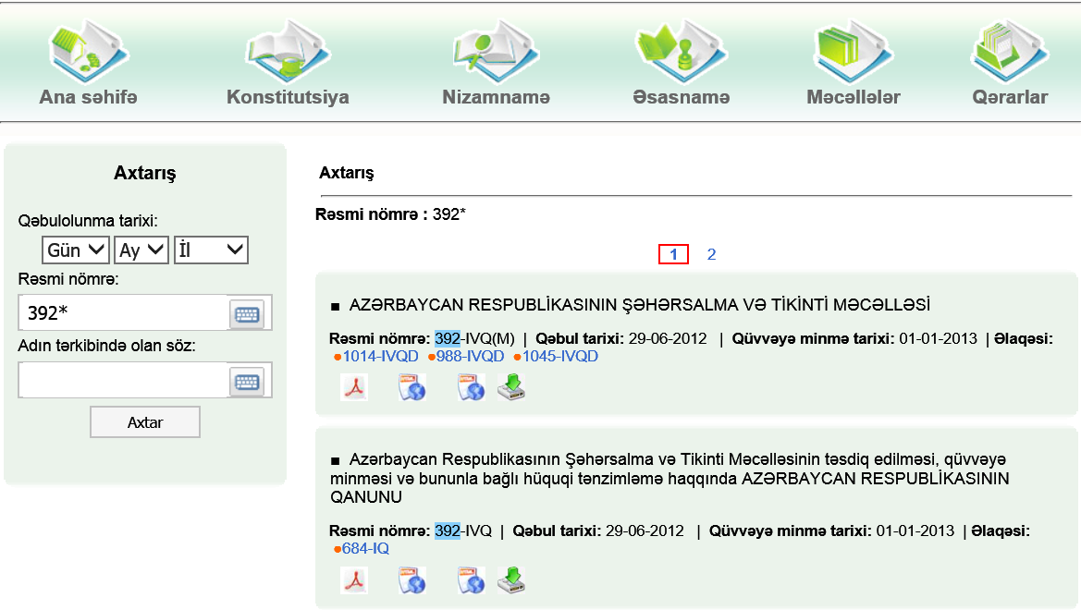
Legislation Information Tracking System(LITS)
Home page
Constitution
Regulations
Principles
Codex
Statue
List of the law
The bill's history
The title of the Law
Search by:
  Number of law
Title of law
Shahin Hasanov, Head of Department on Information Resources and Technologies
Email:shahinhasanov@meclis.gov.az, shahinhasanov@hotmail.com
The Milli Mejlis (Parliament) of the Republic of Azerbaijan

Slide 12

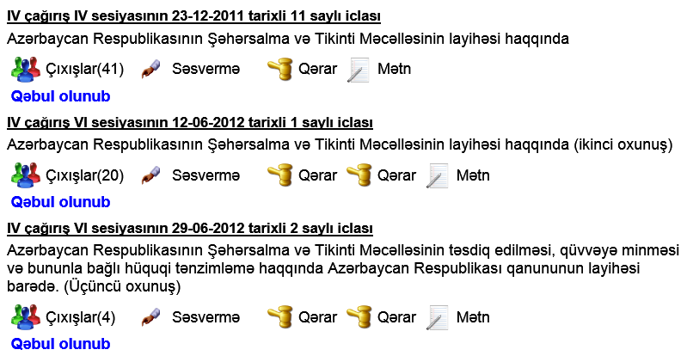
LITS : The bill's history
Date of the sitting
Title of
draft
legislation
1st Reading
2nd Reading
3rd Reading
Shahin Hasanov, Head of Department on Information Resources and Technologies
Email:shahinhasanov@meclis.gov.az, shahinhasanov@hotmail.com
The Milli Mejlis (Parliament) of the Republic of Azerbaijan

Slide 13
LITS : The bill's history
Floor actions:
  List of the speaker
  Vote details
1st Reading
2nd Reading
3rd Reading
Shahin Hasanov, Head of Department on Information Resources and Technologies
Email:shahinhasanov@meclis.gov.az, shahinhasanov@hotmail.com
The Milli Mejlis (Parliament) of the Republic of Azerbaijan

Slide 14
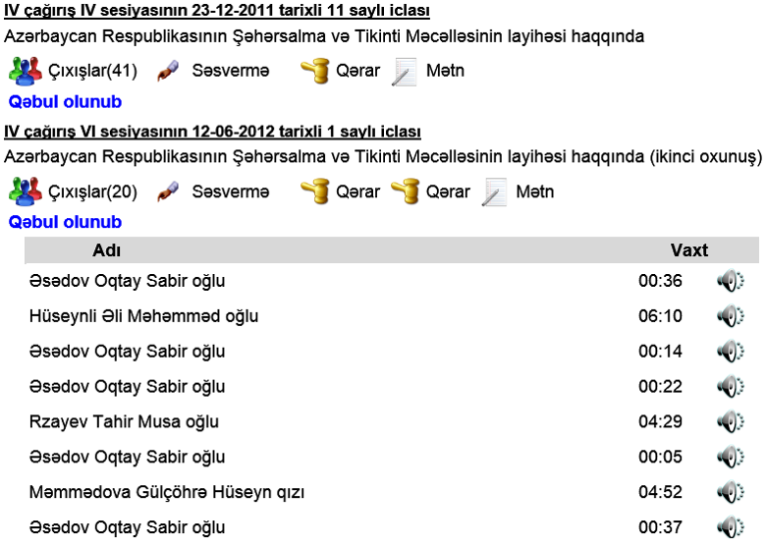
LITS : The bill's history
1st Reading
2nd Reading
Shahin Hasanov, Head of Department on Information Resources and Technologies
Email:shahinhasanov@meclis.gov.az, shahinhasanov@hotmail.com
The Milli Mejlis (Parliament) of the Republic of Azerbaijan

Slide 15
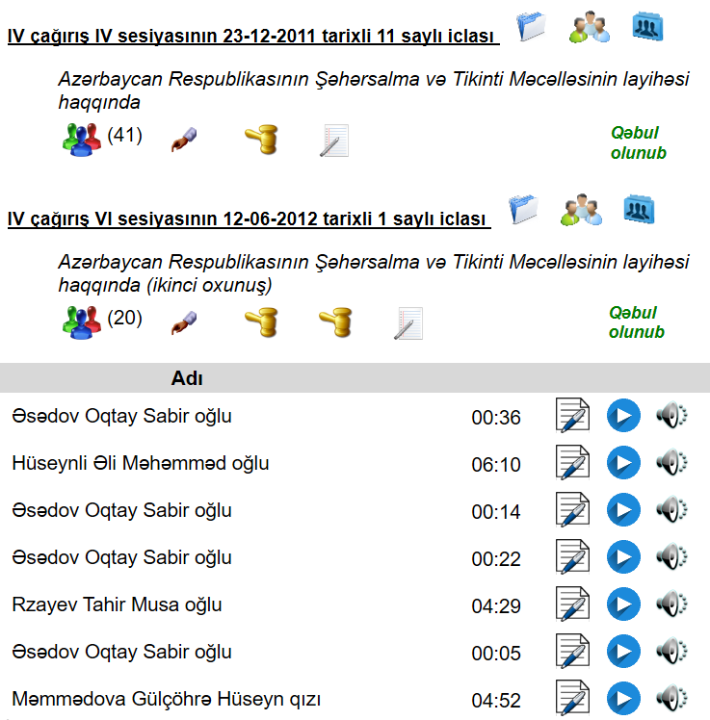

LITS : The bill's history
1st Reading
2nd Reading
Shahin Hasanov, Head of Department on Information Resources and Technologies
Email:shahinhasanov@meclis.gov.az, shahinhasanov@hotmail.com
The Milli Mejlis (Parliament) of the Republic of Azerbaijan

Slide 16
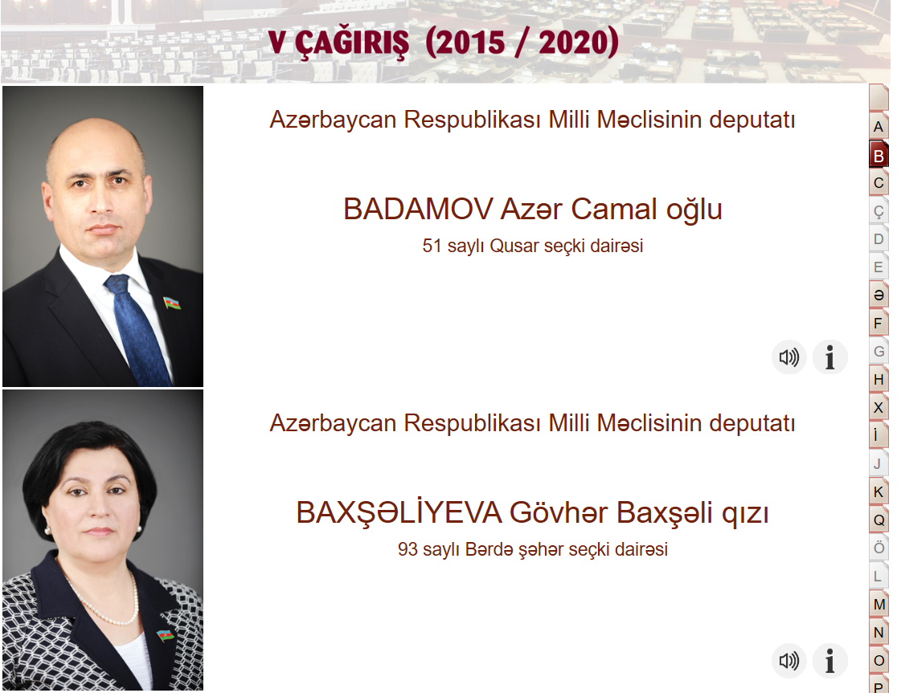
MP’s Activities
V convocation
Election constituency
Alphabet of the Azerbaijani language
Shahin Hasanov, Head of Department on Information Resources and Technologies
Email:shahinhasanov@meclis.gov.az, shahinhasanov@hotmail.com
The Milli Mejlis (Parliament) of the Republic of Azerbaijan

Slide 17
MP’s Activities
V convocation
MP autobiography
MP speeches
Shahin Hasanov, Head of Department on Information Resources and Technologies
Email:shahinhasanov@meclis.gov.az, shahinhasanov@hotmail.com
The Milli Mejlis (Parliament) of the Republic of Azerbaijan

Slide 18
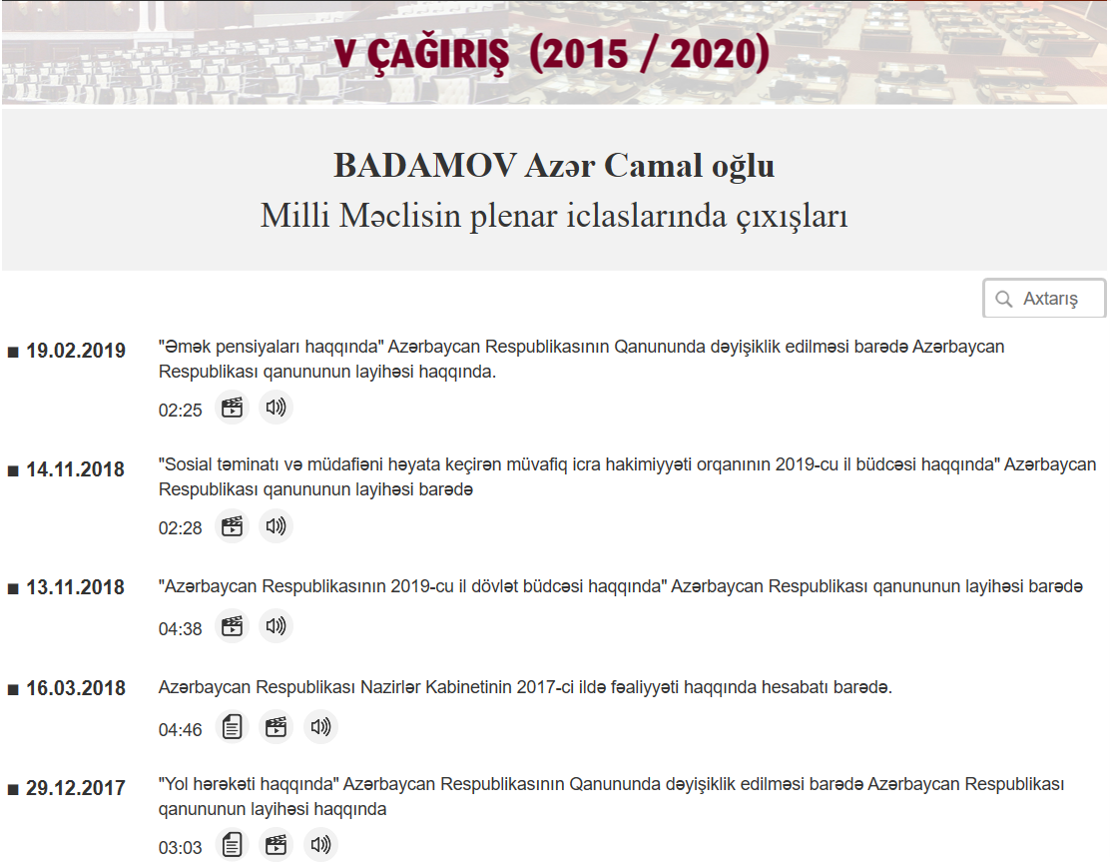
MP’s Activities: MP speeches
Titles of
draft
legislation
... … …
Shahin Hasanov, Head of Department on Information Resources and Technologies
Email:shahinhasanov@meclis.gov.az, shahinhasanov@hotmail.com
The Milli Mejlis (Parliament) of the Republic of Azerbaijan

Slide 19



MP’s Activities: MP speeches
The text
The video
The audio
... … …
Shahin Hasanov, Head of Department on Information Resources and Technologies
Email:shahinhasanov@meclis.gov.az, shahinhasanov@hotmail.com
The Milli Mejlis (Parliament) of the Republic of Azerbaijan

Slide 20
Audio recording processes
Audio record software
Audio recordings of the entire meeting
Audio recording on any given time interval, for stenographers
Audio recordings for whom a microphone is turned on
thread
thread
thread
Shahin Hasanov, Head of Department on Information Resources and Technologies
Email:shahinhasanov@meclis.gov.az, shahinhasanov@hotmail.com
The Milli Mejlis (Parliament) of the Republic of Azerbaijan

Slide 21
Video recording processes
Video record software
Video recordings
of the
entire meeting
Split video records into files for every speaker
thread
Shahin Hasanov, Head of Department on Information Resources and Technologies
Email:shahinhasanov@meclis.gov.az, shahinhasanov@hotmail.com
The Milli Mejlis (Parliament) of the Republic of Azerbaijan

Slide 22

Video recording processes
Video record software
Video recordings
of the
entire meeting
Split video records into files for every speaker
thread
Nginx
Video module support
“module provides pseudo-streaming server-side support for MP4 files”
http://example.com/example.mp4? start=8186&end=8331
Shahin Hasanov, Head of Department on Information Resources and Technologies
Email:shahinhasanov@meclis.gov.az, shahinhasanov@hotmail.com
The Milli Mejlis (Parliament) of the Republic of Azerbaijan

Slide 23
Using time stamps to define an argument start & end
http://example.com/example.mp4?start=8186&end=8331
We have :
      t₀ - the time, when a sitting is began,(11.57.13)
      t_{e} - the time, when a sitting is over,(13.52.53;)
      t_{i} -the time, when microphone is turn on, (13.54.48)
      tcur - duration of speech, (02:25)
There are two options:
Audio and video recordings are synchronized
  start=(t_{i}-t₀); end=start+tcur
Audio and video recordings are not synchronized
start=(t_{i}-t₀)+∆; end=start+tcur
∆ - it is determined by the operator watching the video for two timestamps
Shahin Hasanov, Head of Department on Information Resources and Technologies
Email:shahinhasanov@meclis.gov.az, shahinhasanov@hotmail.com
The Milli Mejlis (Parliament) of the Republic of Azerbaijan

Slide 24
Using time stamps to define an argument start & end for plenary meetings with breaks
http://example.com/example.mp4?start=8186&end=8331
We have :
      t₀ - the time, when a sitting is began.(11.57.13 15.57.25 )
      t_{e} - the time, when a sitting is over. (13.52.53 17.50.47 )
      t_{i} -the time, when microphone is turn on, (13.54.48)
      tcur - duration of speech, (02:25)
There are two options:
Audio and video recordings are synchronized
  I part: start=(t_{i}-t₁₀);
  II part: start=(t_{i}-t₂₀);
Audio and video recordings are not synchronized
I part: start=(t_{i}-t₁₀)+∆;
II part: start=(t_{i}-t₂₀)+∆ && t_{1e}=t_{1e}+∆₁
I part
II part
end=start+tcur
end=start+tcur
Shahin Hasanov, Head of Department on Information Resources and Technologies
Email:shahinhasanov@meclis.gov.az, shahinhasanov@hotmail.com
The Milli Mejlis (Parliament) of the Republic of Azerbaijan

Slide 25
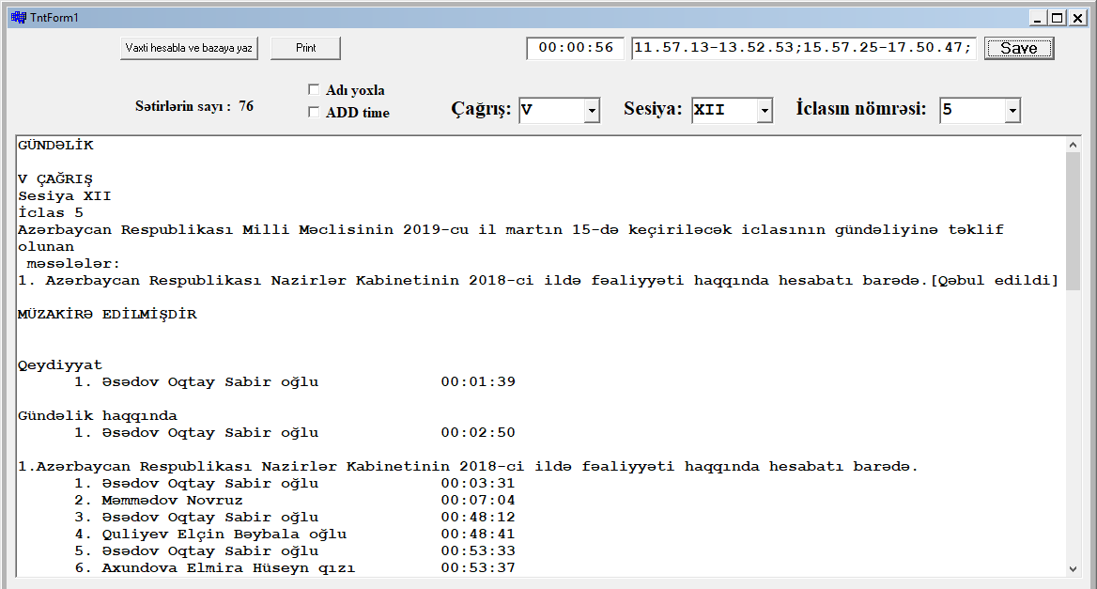
The tool for define an argument start & end
∆
I part
II part
Shahin Hasanov, Head of Department on Information Resources and Technologies
Email:shahinhasanov@meclis.gov.az, shahinhasanov@hotmail.com
The Milli Mejlis (Parliament) of the Republic of Azerbaijan

Slide 26
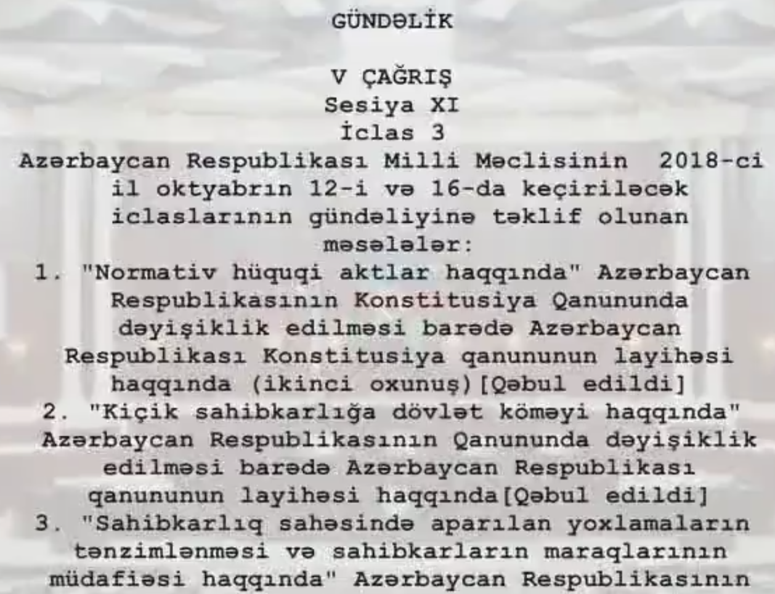
The beginning of video file :Contents
Agenda
Status of the
legislation
Shahin Hasanov, Head of Department on Information Resources and Technologies
Email:shahinhasanov@meclis.gov.az, shahinhasanov@hotmail.com
The Milli Mejlis (Parliament) of the Republic of Azerbaijan

Slide 27
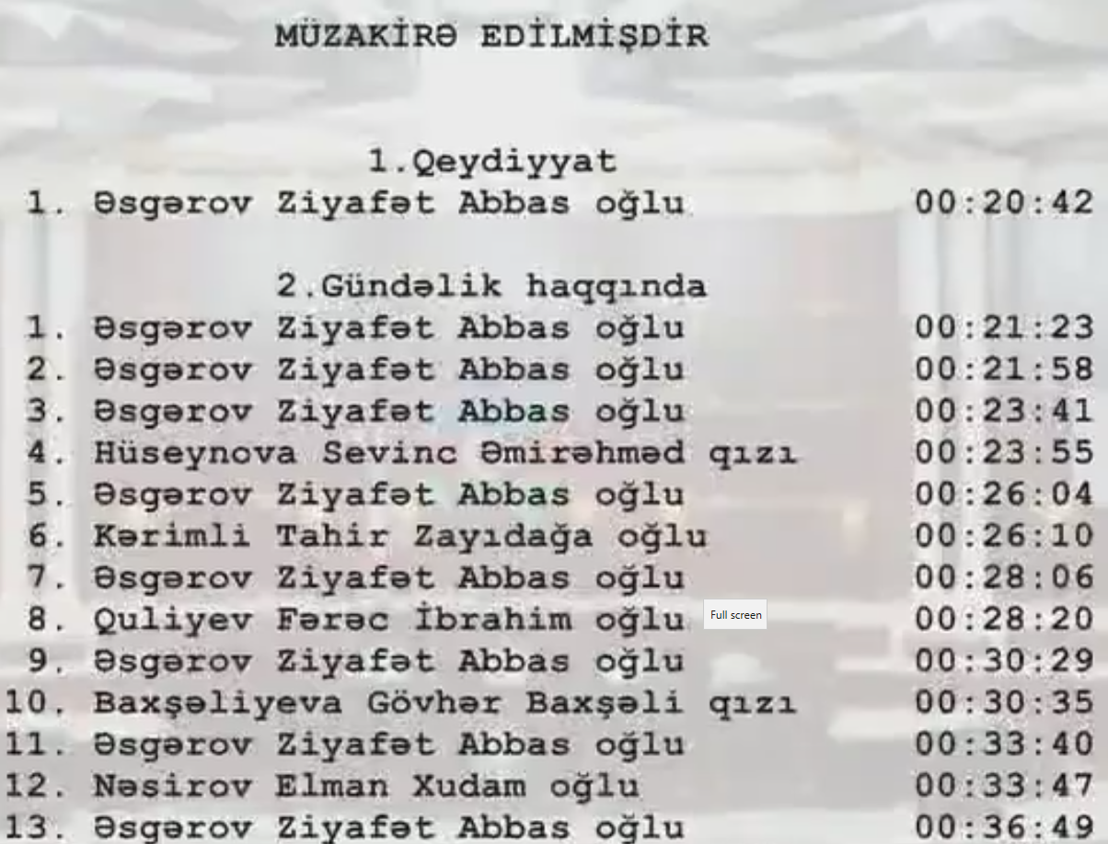
The beginning of video file : Contents
Discussion
about agenda
The timestamp on video for a speaker
Shahin Hasanov, Head of Department on Information Resources and Technologies
Email:shahinhasanov@meclis.gov.az, shahinhasanov@hotmail.com
The Milli Mejlis (Parliament) of the Republic of Azerbaijan

Slide 28
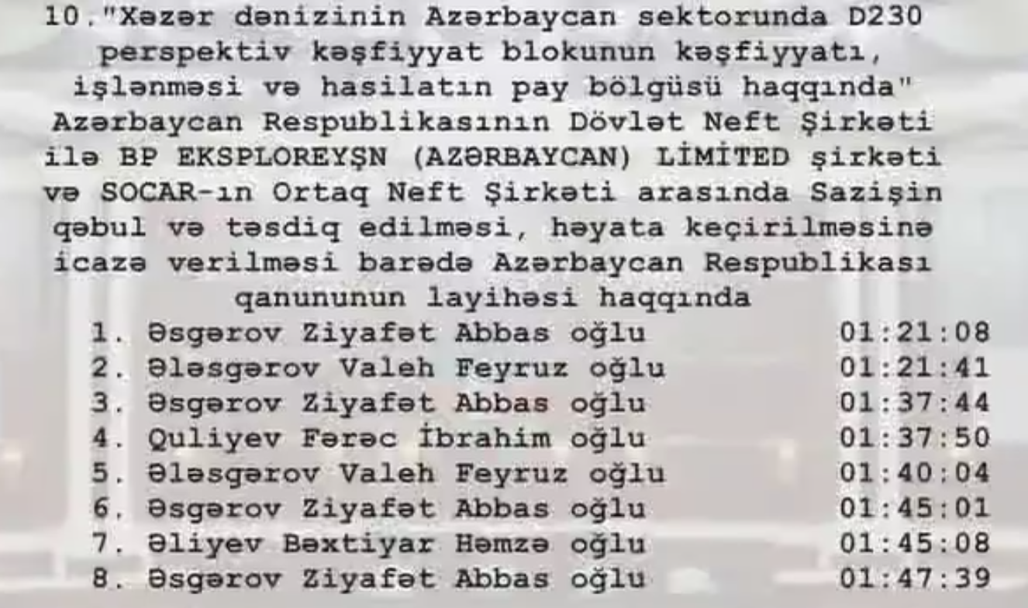
The beginning of video file : Contents ∆_{c}
Discussion about the legislation
Shahin Hasanov, Head of Department on Information Resources and Technologies
Email:shahinhasanov@meclis.gov.az, shahinhasanov@hotmail.com
The Milli Mejlis (Parliament) of the Republic of Azerbaijan

Slide 29
THANK YOU FOR YOUR
ATTENTION
?
Shahin Hasanov, Head of Department on Information Resources and Technologies
Email:shahinhasanov@meclis.gov.az, shahinhasanov@hotmail.com
The Milli Mejlis (Parliament) of the Republic of Azerbaijan

