Slide 1
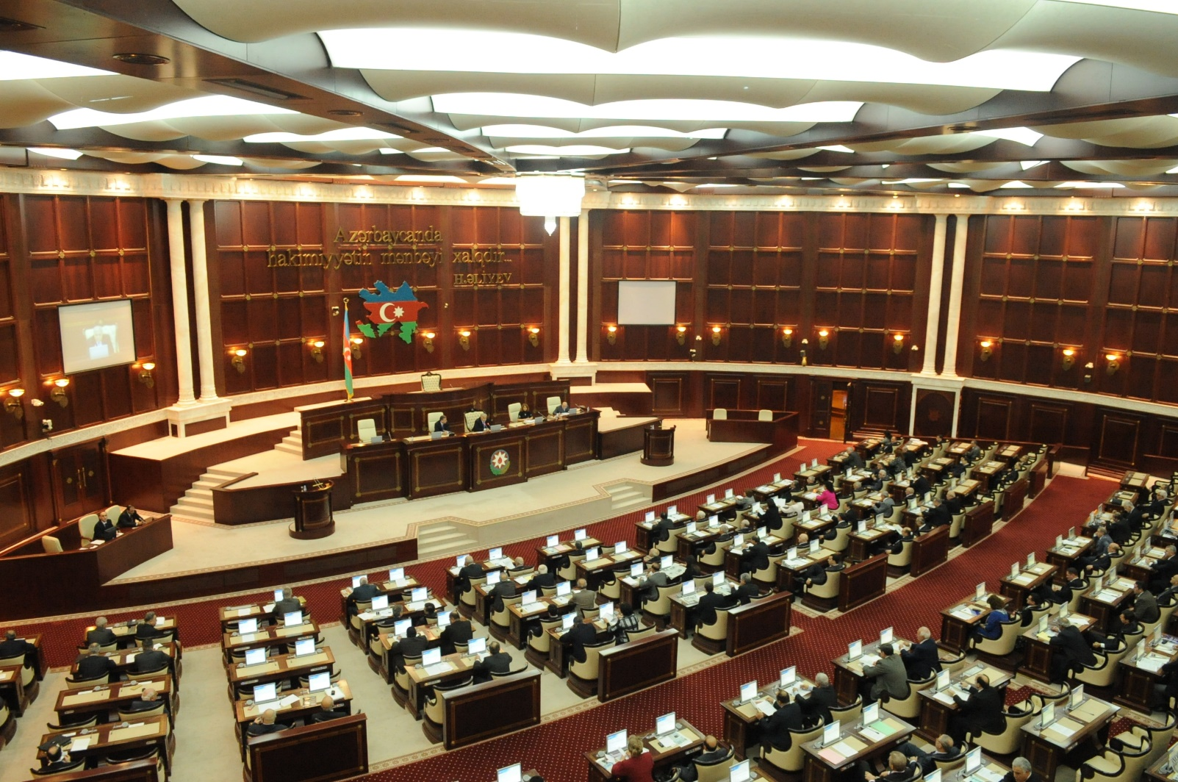
TO “E-PARLIAMENT” step by step
Shahin Hasanov, Head of Department on Information Resources and Technologies
Email:shahinhasanov@meclis.gov.az, shahinhasanov@hotmail.com
The Milli Mejlis (Parliament) of the Republic of Azerbaijan

Slide 2
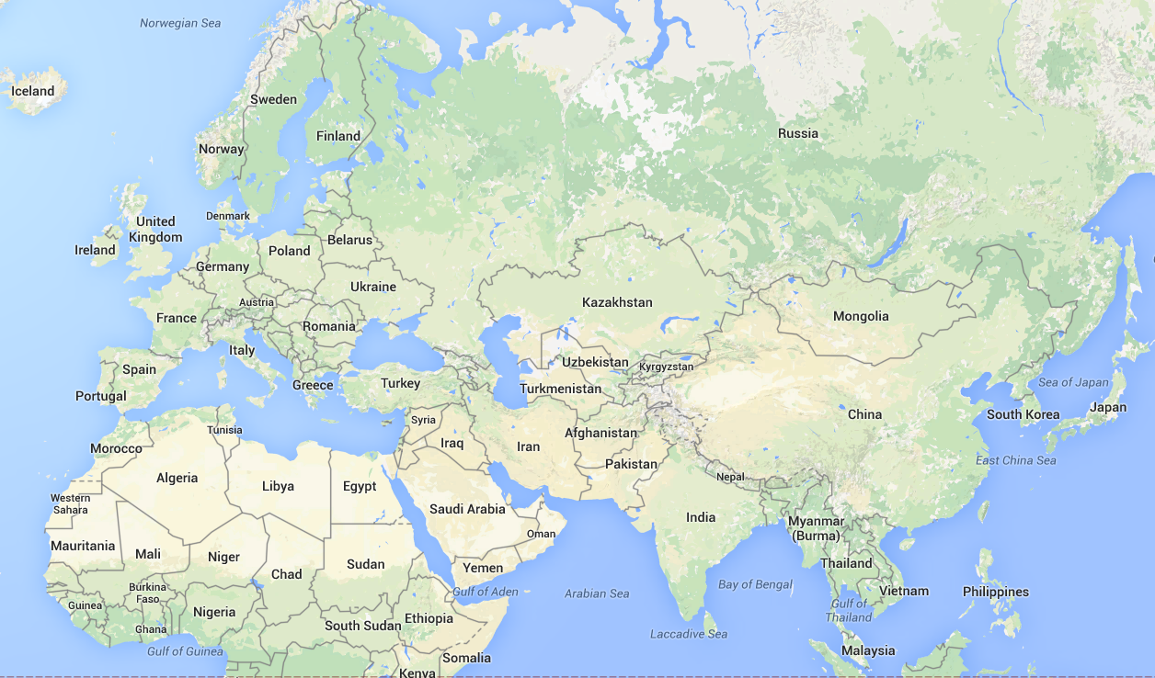
All presentations on a way to e-parliament
Sankt-Petersburg, ECPRD, September 19-21, 2013
London, ECPRD, September 19-21, 2013
Brussels, ECPRD, April 16-17, 2015
Strasbourg ,ECPRD, December 18-19, 2014
Ljubljana, ECPRD, June 5-6, 2014
Baku, ECPRD, November 28-29, 2013
Seoul, IPU,
May 8-10, 2014
Shahin Hasanov, Head of Department on Information Resources and Technologies
Email:shahinhasanov@meclis.gov.az, shahinhasanov@hotmail.com
The Milli Mejlis (Parliament) of the Republic of Azerbaijan

Slide 3
On September of 2013: European Centre for Parliamentary Research and Documentation (ECPRD)
Legislative Information Management Application (LIMA) Contributes to Improving Lawmaking in Azerbaijan:
    Description of lawmaking process in Azerbaijan
    Briefly description of the approach to registering audio recording of speech by speaker in the sitting.
Shahin Hasanov, Head of Department on Information Resources and Technologies
Email:shahinhasanov@meclis.gov.az, shahinhasanov@hotmail.com
The Milli Mejlis (Parliament) of the Republic of Azerbaijan

Slide 4
On Novebmer of 2013: European Centre for Parliamentary Research and Documentation (ECPRD)
The Milli Mejlis of the Azerbaijan Republic was hosted the ECPRD seminar "Area of Interest ICT in Parliament”
  7 presentations was made by ICT staff of the Milli Mejlis (http://meclis.az/ecprd2013/)
  More attention was paid to the technical issue of the system
Shahin Hasanov, Head of Department on Information Resources and Technologies
Email:shahinhasanov@meclis.gov.az, shahinhasanov@hotmail.com
The Milli Mejlis (Parliament) of the Republic of Azerbaijan

Slide 5
On May of 2014: Inter-Parliamentary Union (IPU),
World e-Parliament Conference 2014
Rethinking Approaches for Publishing Parliamentary Proceedings
  A new method of publishing parliamentary proceeding was proposed in three options (http://meclis.az/software/?pg=present) :
  In Manual Mode
  In semi-automated mode
  In Automatic mode
  Main goal was is the fastest method.
  The approach does not required transform speech to TEXT
Shahin Hasanov, Head of Department on Information Resources and Technologies
Email:shahinhasanov@meclis.gov.az, shahinhasanov@hotmail.com
The Milli Mejlis (Parliament) of the Republic of Azerbaijan

Slide 6
On June of 2014: ECPRD SEMINAR: STENOGRAPHIC RECORDS: HANSARD IN THE 21ST CENTURY
E-Hansard: Digital Mirror of Legislative Procedure, Practices and Records
    Requirements for the publication of parliamentary proceedings were given
    A comparative analysis was made of our method with the data of the handbook "Technological options for capturing and reporting parliamentary proceeding" .
Shahin Hasanov, Head of Department on Information Resources and Technologies
Email:shahinhasanov@meclis.gov.az, shahinhasanov@hotmail.com
The Milli Mejlis (Parliament) of the Republic of Azerbaijan

Slide 7
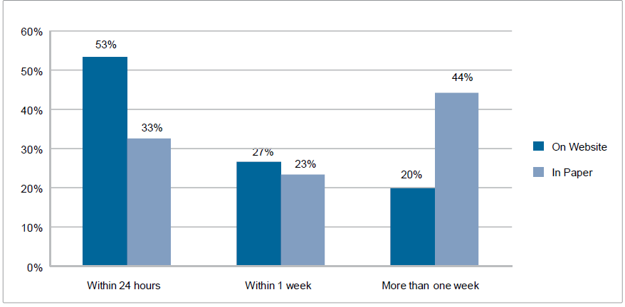
Quickly …
Best result for verbatim record is 2 hours after the meeting
Average time to publish verbatim records of the plenary proceedings
Final report needs more time

Slide 8
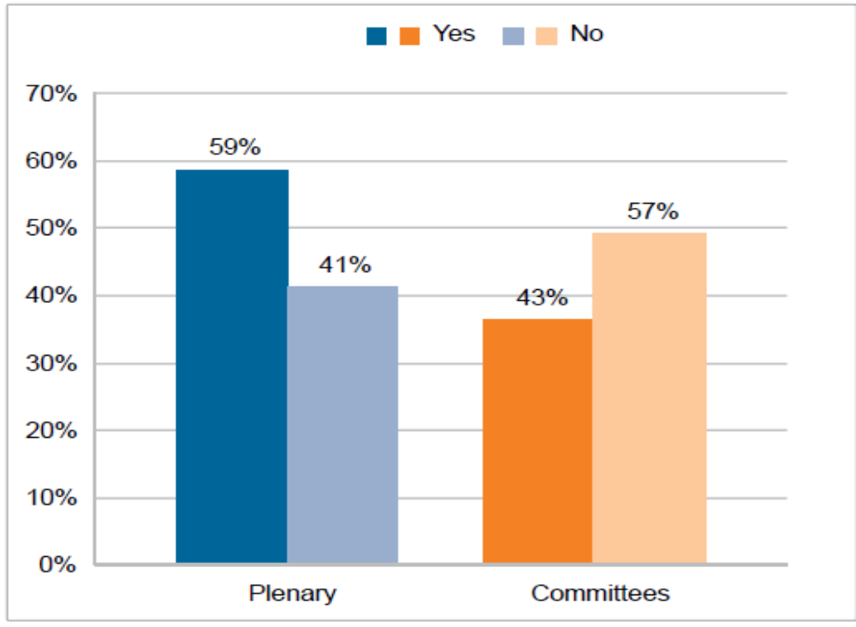
Accurately …
59% of parliaments make changes in order to make it understandable
Members of parliament are allowed to revise verbatim record
Challenge:
what type of corrections to allow by reporters and editors to do on text format in order to make it understandable

Slide 9
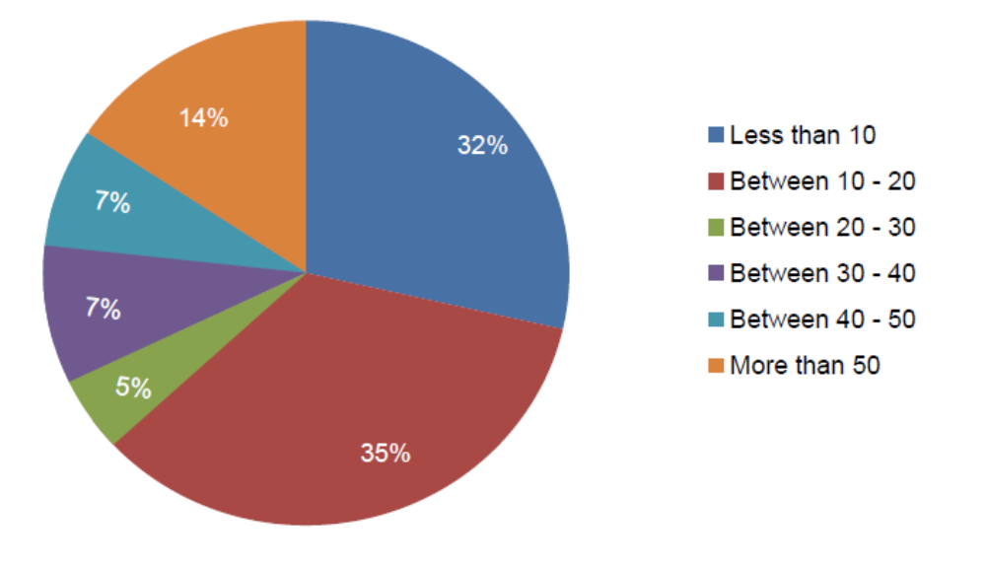
Effectively …
Requires sufficient resources like:
Staff
IT tools
Total number of staff responsible for preparing
and processing verbatim records of plenary
and committee proceedings

Slide 10
Efficiently …
Requires sufficient resources like
Staff
IT tools
Total number of staff responsible for preparing and processing verbatim records of plenary
and committee proceedings
68 % of parliaments hire more than 10 staff persons
Staff must be knowledgeable about the legislative process
Typing on a stenographic machine
Typing on a PC
Voice-to-text system

Slide 11
On June of 2014: ECPRD SEMINAR: STENOGRAPHIC RECORDS: HANSARD IN THE 21ST CENTURY
We learned from the editors of their problems
  Human never speaks grammatically correctly
  On some parliaments MP’s can put pressure to a editor to change speech in text format.
Shahin Hasanov, Head of Department on Information Resources and Technologies
Email:shahinhasanov@meclis.gov.az, shahinhasanov@hotmail.com
The Milli Mejlis (Parliament) of the Republic of Azerbaijan

Slide 12
On Desember of 2014: Workshop "Search in Parliamnets" 7th edition, Strasbourg
Indexation of Parliamentary Data and Processes
  It was described three systems:
    E-Verbatim Records of Plenary Meetings
    E-Minutes of Plenary Meetings
    Legislation Information Tracking System
Shahin Hasanov, Head of Department on Information Resources and Technologies
Email:shahinhasanov@meclis.gov.az, shahinhasanov@hotmail.com
The Milli Mejlis (Parliament) of the Republic of Azerbaijan

Slide 13
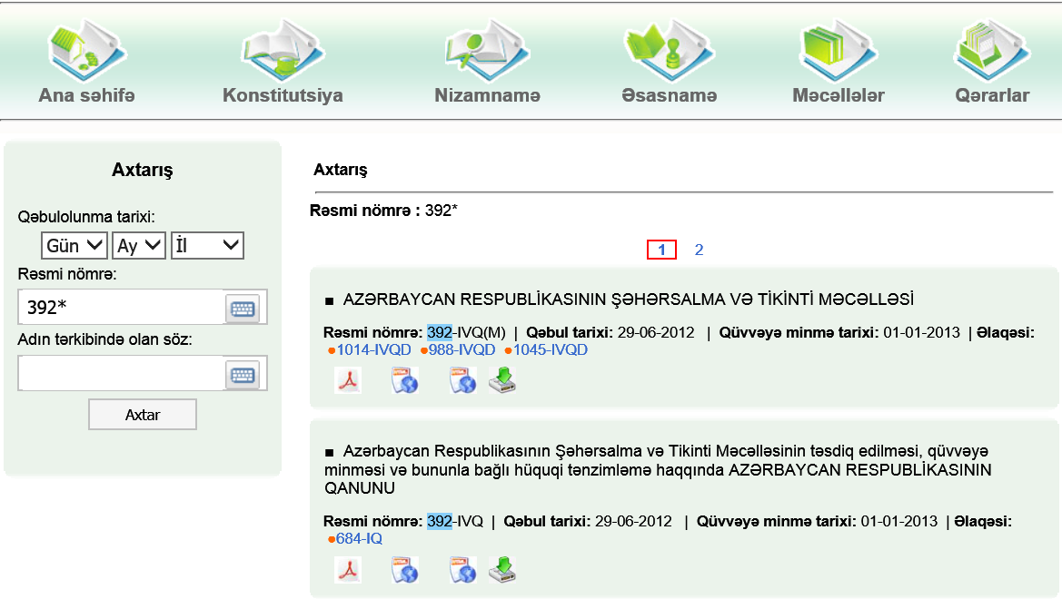
Legislation Information Tracking System
Home page
Constitution
Regulations
Principles
Codex
Statue
Search by:
Law number
Title
Provisions
List of the law

Slide 14
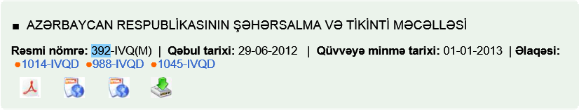
Legislation Information Tracking System
The title of the Law
Date of adoption
Date of enactment
Number of the law
Number of law (s) which make amends to this law

Slide 15
Legislation Information Tracking System
The bill's history
Text of the law without amendments in pdf and html format
Text of the law with amendments in html format

Slide 16

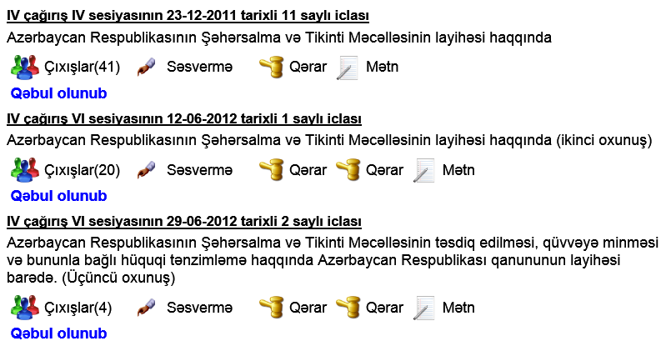
Legislation Information Tracking System
History of the bill
1st Reading
Date of the sitting
2nd Reading
3rd Reading

Slide 17
Legislation Information Tracking System
History of the bill
1st Reading
Floor actions
2nd Reading
List of the speaker
- name of MP’s
- audio file
Vote details
3rd Reading

Slide 18
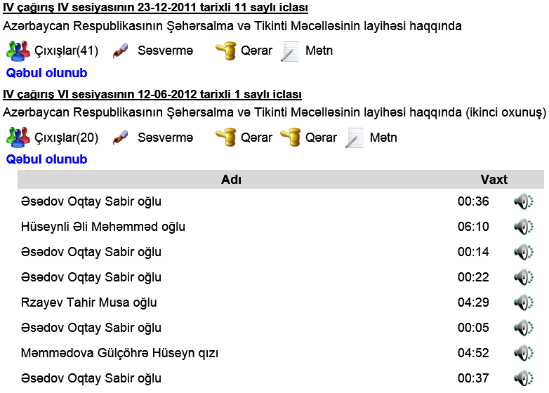
Legislation Information Tracking System
History of the bill
1st Reading
2nd Reading
Floor actions
List of the speaker
- name of MP’s
- audio file

Slide 19
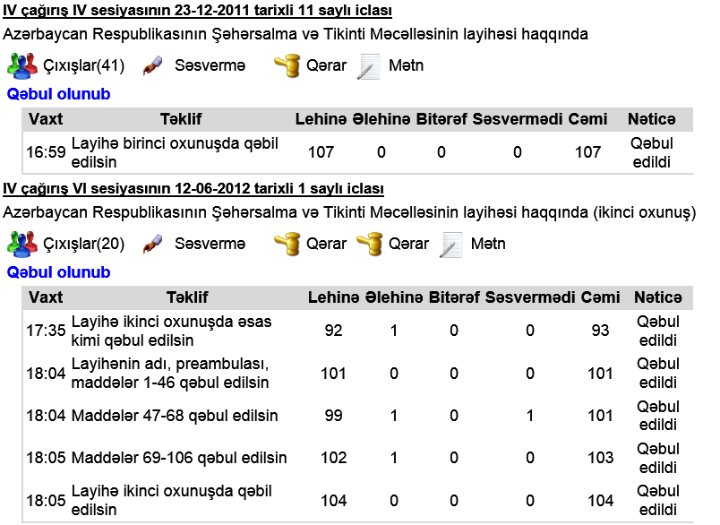
Legislation Information Tracking System
History of the bill
1st Reading
The proposals for the vote
2nd Reading

Slide 20
Legislation Information Tracking System
History of the bill
1st Reading
Other related documents
text of the bill on each sitting
Committee resolution on each sitting
2nd Reading
3rd Reading

Slide 21
On 2014 : It was devol0oped a new website:
The method and tools for publishing Parliamentary proceedings. (http://meclis.az/software/)
Download
Documents
Presentations
Shahin Hasanov, Head of Department on Information Resources and Technologies
Email:shahinhasanov@meclis.gov.az, shahinhasanov@hotmail.com
The Milli Mejlis (Parliament) of the Republic of Azerbaijan

Slide 22
On 2015 : ECPRD seminar: Communication, Digitalisation of Processes and Transparency in Parliaments (Parli@ments on the Net XIII) Area of Interest ICT in Parliaments.
Using Legislative Information Management System (LIMS ) in a multilingual parliament
Shahin Hasanov, Head of Department on Information Resources and Technologies
Email:shahinhasanov@meclis.gov.az, shahinhasanov@hotmail.com
The Milli Mejlis (Parliament) of the Republic of Azerbaijan

Slide 23
On 2018 : ECPRD seminar: ECPRD seminar 2018 “Parliamentary Research in a digital age”.
Some of examples on visualization of parliamentary data
Shahin Hasanov, Head of Department on Information Resources and Technologies
Email:shahinhasanov@meclis.gov.az, shahinhasanov@hotmail.com
The Milli Mejlis (Parliament) of the Republic of Azerbaijan

Slide 24
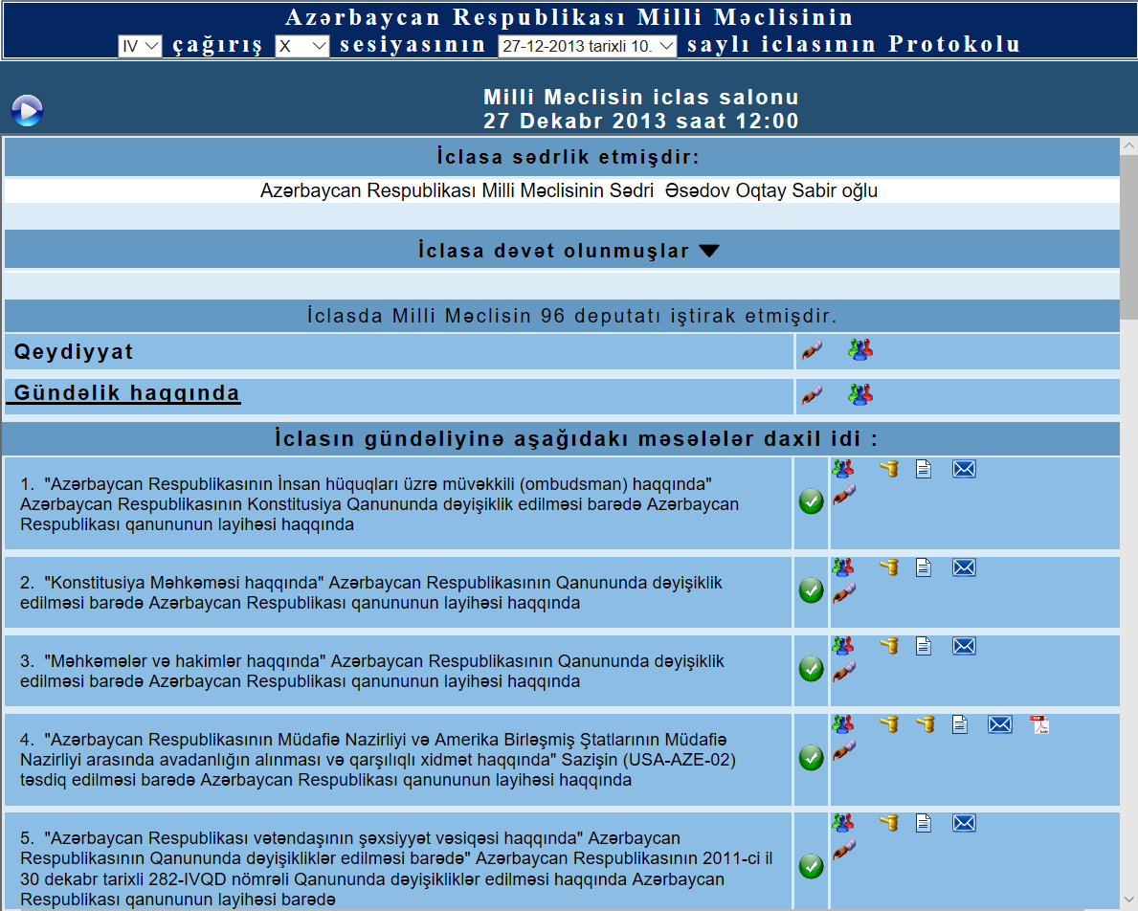
E-Minutes
Convocation
Session
Date & number of meeting
Video
beginning of the meeting
chairman of the meeting
Accompanying documents of the draft legislation
List of guests
Registration
Number of present MP's
Discussion about
the agenda
Agenda
Shahin Hasanov, Head of Department on Information Resources and Technologies
Email:shahinhasanov@meclis.gov.az, shahinhasanov@hotmail.com
The Milli Mejlis (Parliament) of the Republic of Azerbaijan

Slide 25
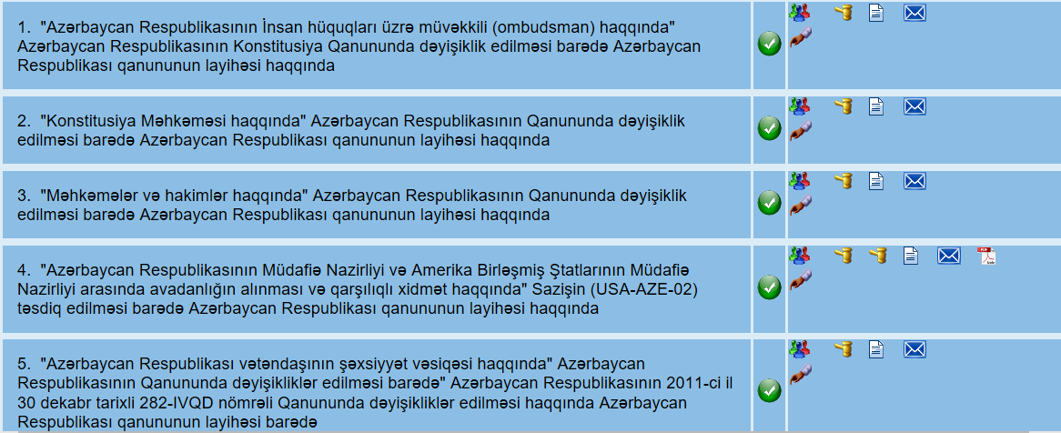
E-Minutes
Status of the draft law
Events of the meeting related
to the draft legislation
The text and accompanying documents of the draft legislation
Agenda: Titles of draft legislation
Shahin Hasanov, Head of Department on Information Resources and Technologies
Email:shahinhasanov@meclis.gov.az, shahinhasanov@hotmail.com
The Milli Mejlis (Parliament) of the Republic of Azerbaijan

Slide 26






Signs have used in the Application of E-Minutes
Status of the draft legislation on the meeting:
1)
have not been considered yet
2)
the discussion began
3)
the discussion has been completed, to be continued
4)
adopted
5)
was discussed at the previous meeting
6)
was adopted at the previous meeting
Shahin Hasanov, Head of Department on Information Resources and Technologies
Email:shahinhasanov@meclis.gov.az, shahinhasanov@hotmail.com
The Milli Mejlis (Parliament) of the Republic of Azerbaijan

Slide 27

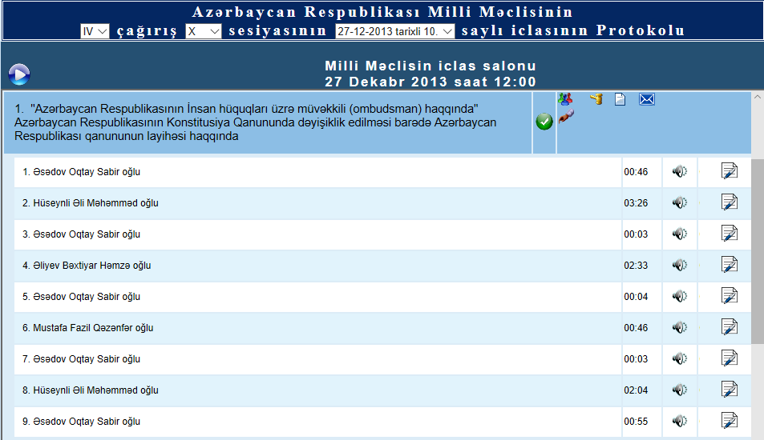


Signs have used in the Application of E-Minutes
List of the speakers on a draft legislation at the meeting
The name of the speaker
The link to the audio file of the speaker’s speech
The text of the speech
Shahin Hasanov, Head of Department on Information Resources and Technologies
Email:shahinhasanov@meclis.gov.az, shahinhasanov@hotmail.com
The Milli Mejlis (Parliament) of the Republic of Azerbaijan

Slide 28
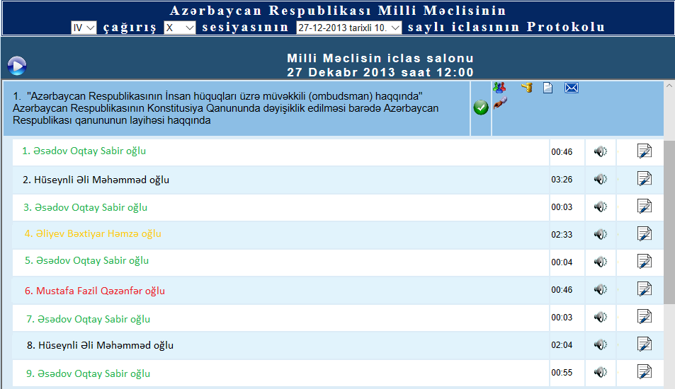
Signs have used in the Application of E-Minutes
List of the speakers on a draft legislation at the meeting
Adding new features in the future, such as a vote of the speaker by color
The name of the speaker with his vote
Yes
No
Abstained
Did not vote
Shahin Hasanov, Head of Department on Information Resources and Technologies
Email:shahinhasanov@meclis.gov.az, shahinhasanov@hotmail.com
The Milli Mejlis (Parliament) of the Republic of Azerbaijan

Slide 29

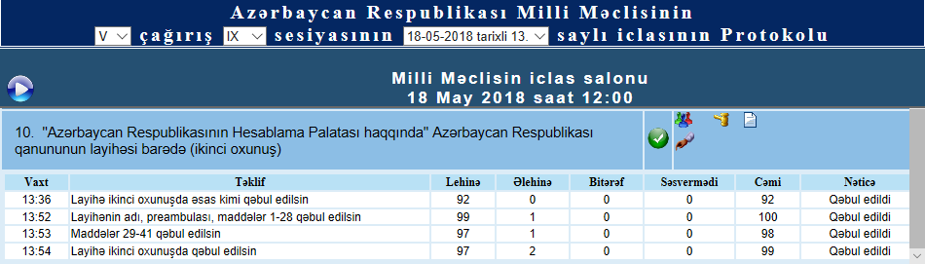
Signs have used in the Application of E-Minutes
Voting results on the draft legislation at the meeting
The time of the vote | Proposal | Yes | No |  | Didn’t vote |  | Decision
Abstained
Total
Shahin Hasanov, Head of Department on Information Resources and Technologies
Email:shahinhasanov@meclis.gov.az, shahinhasanov@hotmail.com
The Milli Mejlis (Parliament) of the Republic of Azerbaijan

Slide 30





Signs have used in the Application of E-Minutes
Accompanying documents of the draft legislation:
Cover letter from the Legislative Initiative body
the text of the draft legislation
the decision of the appropriate committee
explanatory to the text of the draft legislation
other kind of documents. For example:
Reports
Memorandum
Agreement etc.
31 types
Shahin Hasanov, Head of Department on Information Resources and Technologies
Email:shahinhasanov@meclis.gov.az, shahinhasanov@hotmail.com
The Milli Mejlis (Parliament) of the Republic of Azerbaijan

Slide 31
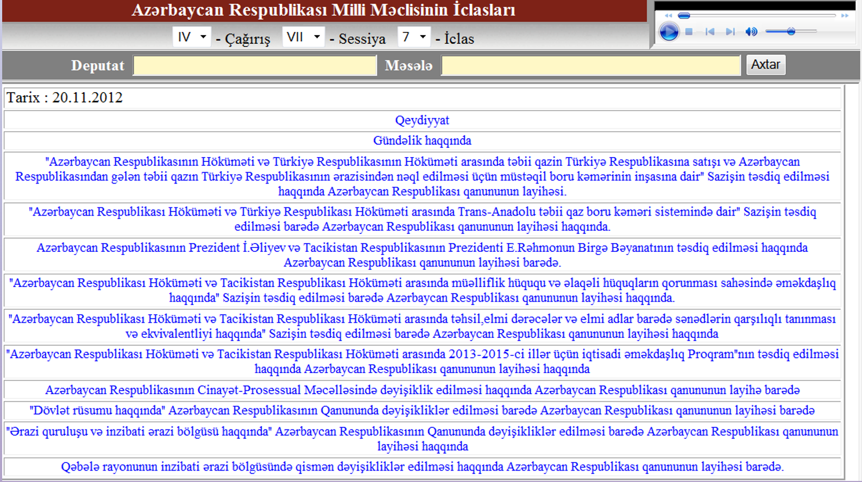
E-Verbatim Records of Plenary Meetings

Slide 32
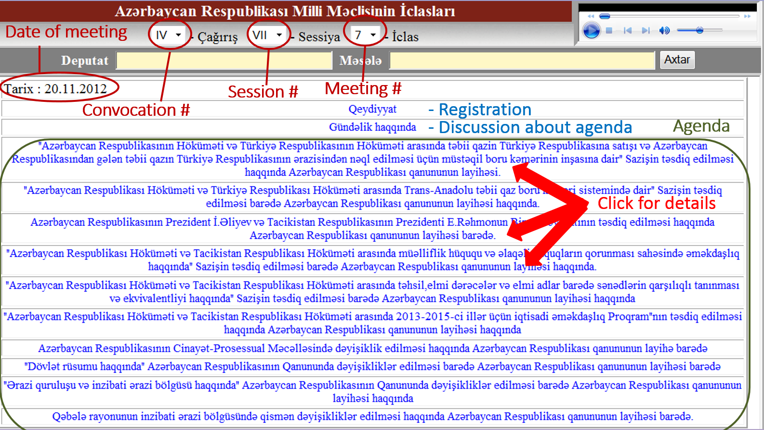
E-Verbatim Records of Plenary Meetings

Slide 33
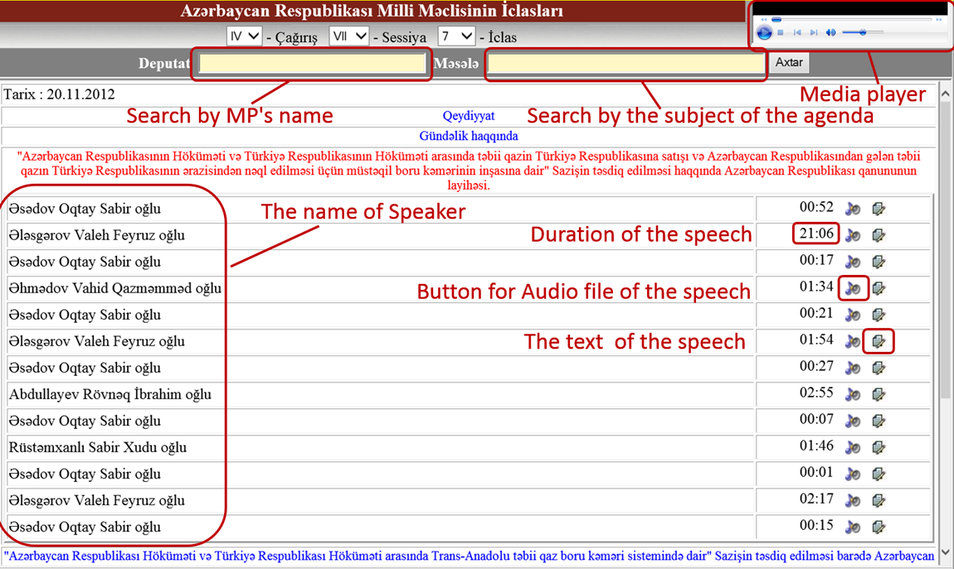
E-Verbatim Records of Plenary Meetings

Slide 34
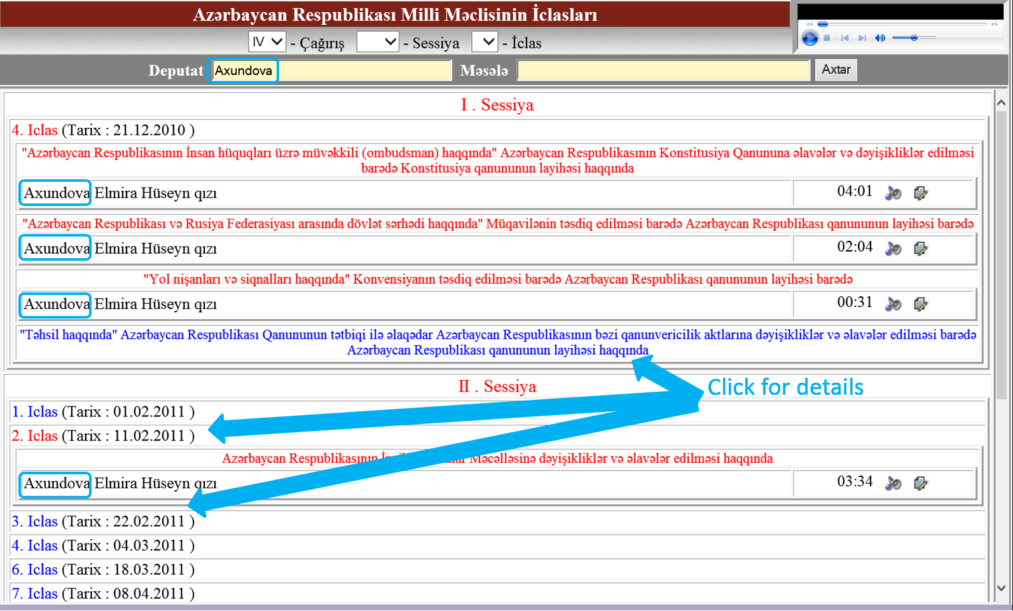
Search by name of the deputy Axudnova in E-Verbatim records

Slide 35
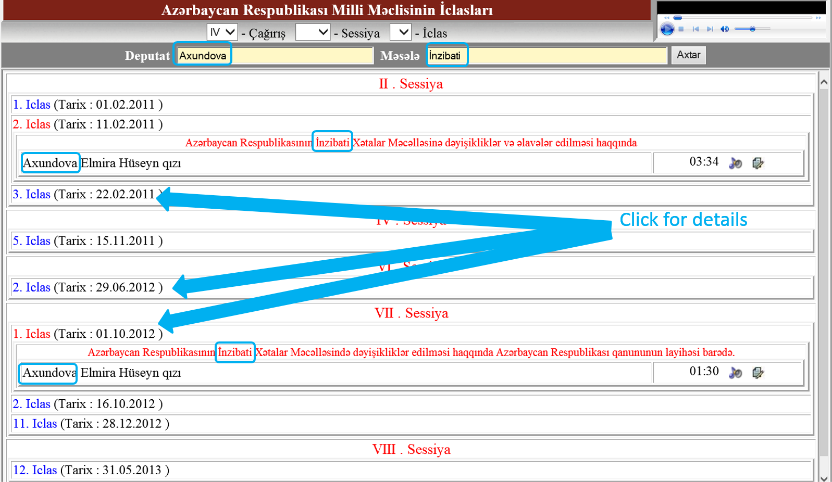
Search by the name of the deputy “Axudnova” on subject “İnzibati” in E-Verbatim records

Slide 36
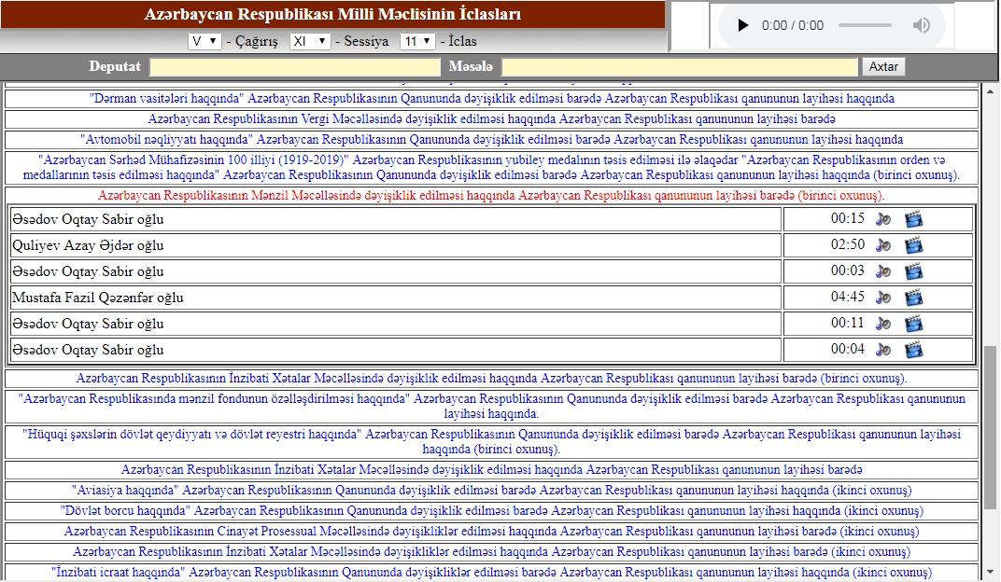
Electronic verbatim records
Shahin Hasanov, Head of Department on Information Resources and Technologies
Email:shahinhasanov@meclis.gov.az, shahinhasanov@hotmail.com
The Milli Mejlis (Parliament) of the Republic of Azerbaijan

Slide 37
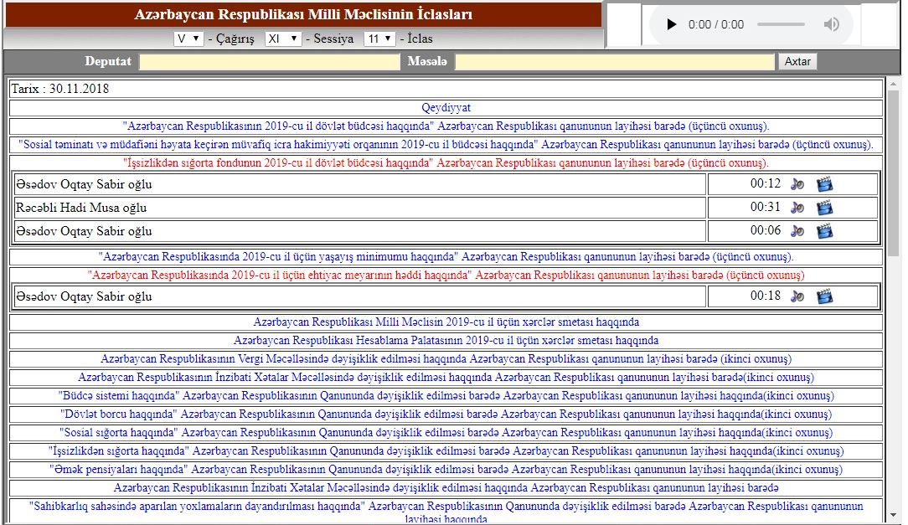
Electronic verbatim records
Shahin Hasanov, Head of Department on Information Resources and Technologies
Email:shahinhasanov@meclis.gov.az, shahinhasanov@hotmail.com
The Milli Mejlis (Parliament) of the Republic of Azerbaijan

Slide 38
Electronic verbatim records
Duration of the speech
button for audio file of speech
NEW feature has been added:
button for video file of speech
Shahin Hasanov, Head of Department on Information Resources and Technologies
Email:shahinhasanov@meclis.gov.az, shahinhasanov@hotmail.com
The Milli Mejlis (Parliament) of the Republic of Azerbaijan

Slide 39
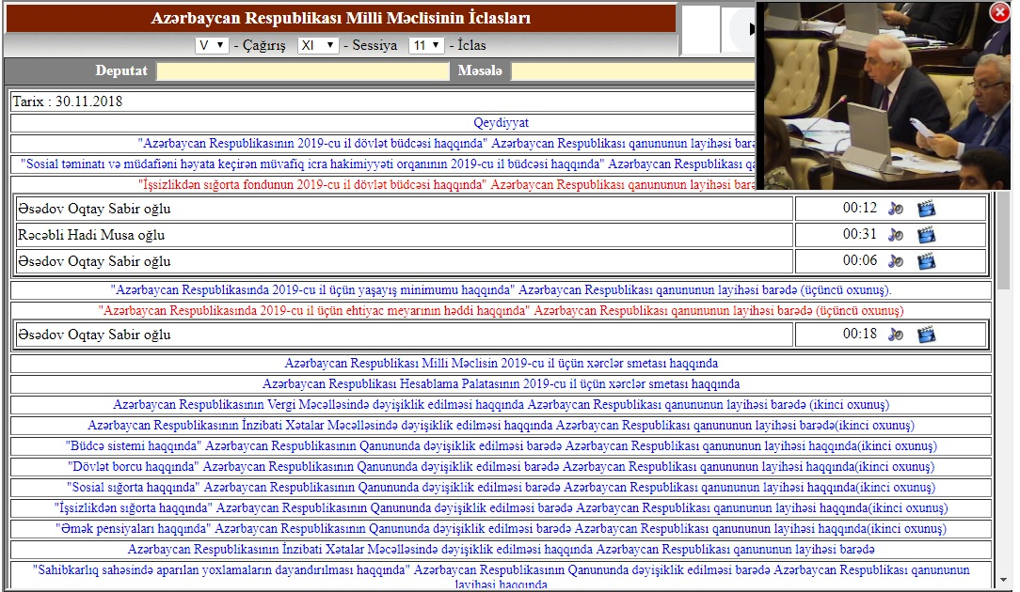
Electronic verbatim records
Shahin Hasanov, Head of Department on Information Resources and Technologies
Email:shahinhasanov@meclis.gov.az, shahinhasanov@hotmail.com
The Milli Mejlis (Parliament) of the Republic of Azerbaijan

Slide 40
Electronic verbatim records
Shahin Hasanov, Head of Department on Information Resources and Technologies
Email:shahinhasanov@meclis.gov.az, shahinhasanov@hotmail.com
The Milli Mejlis (Parliament) of the Republic of Azerbaijan

Slide 41
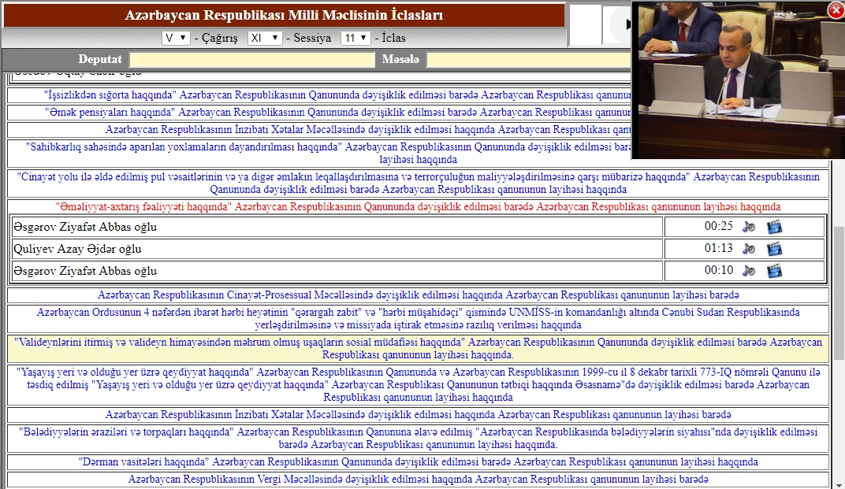
Electronic verbatim records
Shahin Hasanov, Head of Department on Information Resources and Technologies
Email:shahinhasanov@meclis.gov.az, shahinhasanov@hotmail.com
The Milli Mejlis (Parliament) of the Republic of Azerbaijan

Slide 42
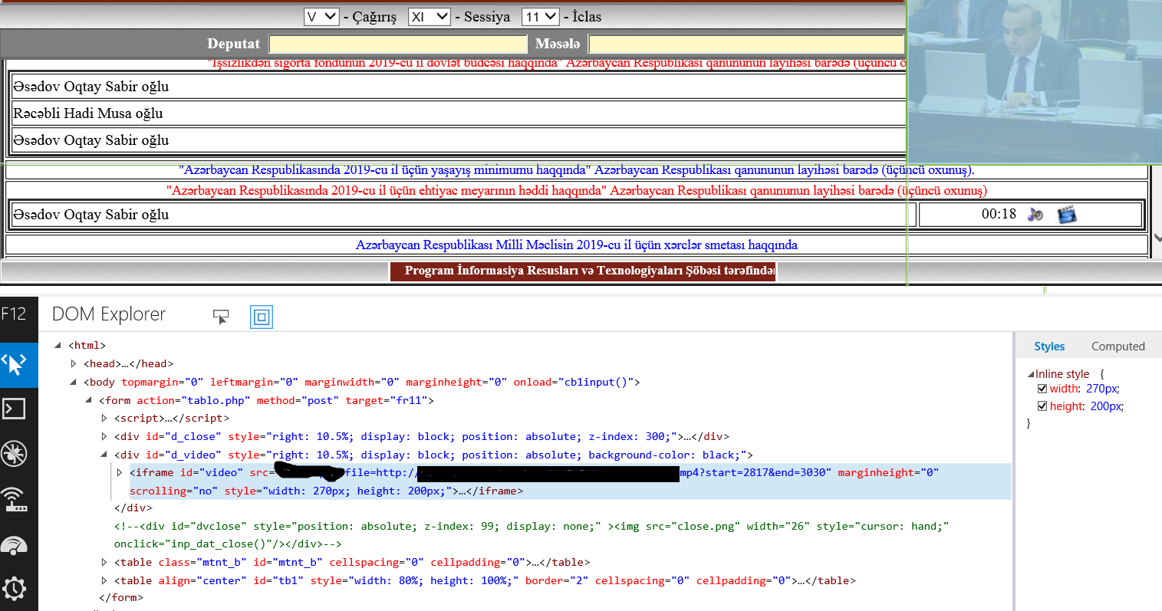
Electronic verbatim records
Video file name? start=2817&end=3030
Shahin Hasanov, Head of Department on Information Resources and Technologies
Email:shahinhasanov@meclis.gov.az, shahinhasanov@hotmail.com
The Milli Mejlis (Parliament) of the Republic of Azerbaijan

Slide 43
THANK YOU FOR YOUR
ATTENTION
?
Shahin Hasanov, Head of Department on Information Resources and Technologies
Email:shahinhasanov@meclis.gov.az, shahinhasanov@hotmail.com
The Milli Mejlis (Parliament) of the Republic of Azerbaijan

